Slide 1

Epileptic Seizure Detection and Notification System
Critical Design Review
Team #19063
Sponsors - Iwan R Grau, James McDowell, Palanivel Guruvareddiar
Mentor - Catherine Merrill
Team members:
Alejandro Ortega
Gordon Downs
Louie Bertani
Juan Gastélum
K Humberto Lopez Felix
Oanh Tran

Slide 2
Objectives of the CDR
Our objectives for CDR are:
Introduce MVP as-built configuration
Introduce MVP verification process and give verification evidence
Explain the impact of our MVP on the overall project
Present requirement decomposition for ISR (the next delivery configuration)
Present the expected design for ISR
We have built and verified our CDR MVP SDNS,
and we are ready to build and verify our ISR MVP SDNS.
Notes:
Alejandro:

Slide 3
CDR Overview
Introduction
Changes Since PDR
PDR Action Items
Requirements Review
System Block Diagrams
System Architecture
System Requirements and SRVM
MVP Definition
Prioritized Requirements
MVP Prototyping Complete
MVP Verification Complete
Analysis and Predictions
Agile Management Process
Configuration Management
Project Plan
Next Design Steps
Expected Design for ISR
Risk Analysis
Cost Analysis
Project Deliverables
Summary

Slide 4
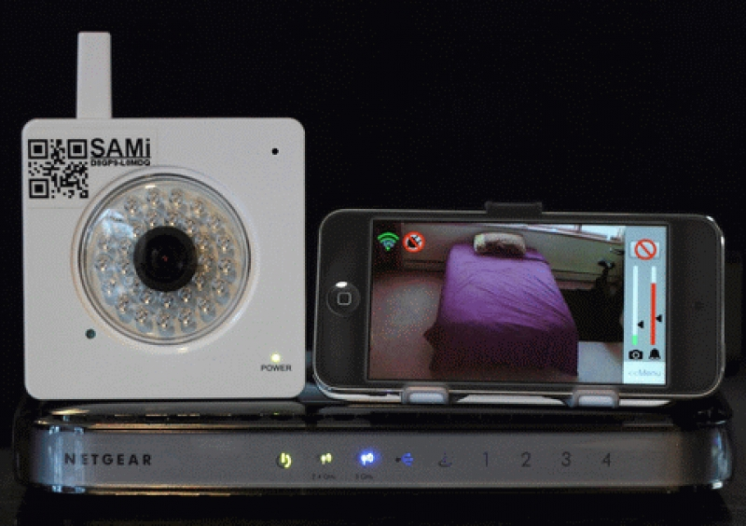
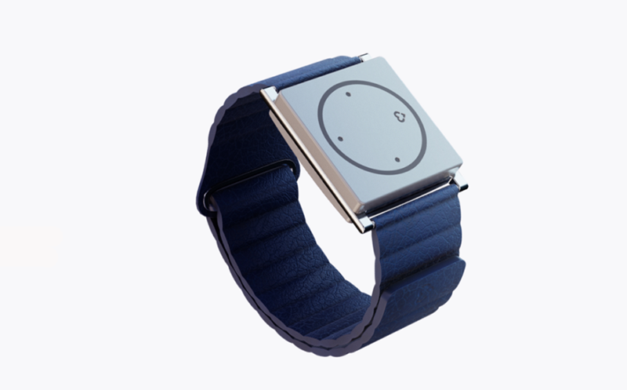
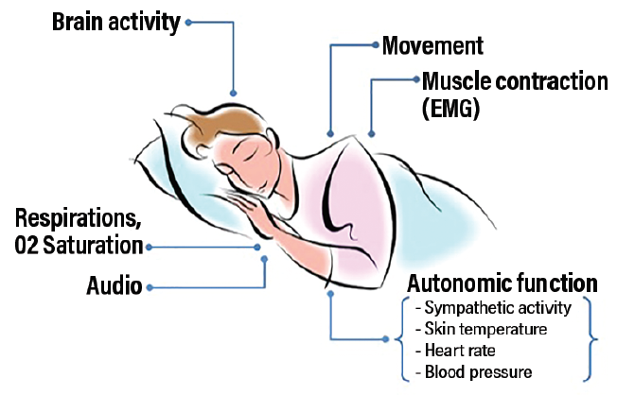
The Problem
1 in every 1,000 individuals with epilepsy dies from sudden unexpected death in epilepsy (SUDEP).^{1,2}
Providing first aid assistance reduces the likelihood of this tragedy from occurring.^{1,2}
Seizure detection systems currently exist but are unreliable and have a negative impact to the patient’s quality of life.
Individuals affected by epilepsy extends past the directly affected. Supporting members can experience a change in quality of life.
Epilepsy affects many individuals, and current detection systems are unreliable.
¹https://www.epilepsy.com/learn/early-death-and-sudep/sudep/sudep-faq
²https://www.cdc.gov/epilepsy/about/sudep/index.htm
Notes:
Juan
Here we need to add a short introduction that explains what is our project and why are we doing it? What is the purpose of dedicating time to build such system.
This supports our thesis statement since we explain our understanding of the project from a high-level perspective and we understand why it is significant to build such system, endorsing the fact that we are ready to start building and verifying our MVP

Slide 5
Our Solution
We have defined our scope to focus on grand mal (tonic-clonic) seizure detection.
Our proposed system will detect seizures remotely and without compromising patient quality of life, allowing caregivers to leave affected individual to the privacy of their bed while preserving comfort.
With a combination of a detection and alert system along with proper first aid assistance can reduce SUDEP risk.
By sending our MVP to clinical trial we can collect data from real patients to train out algorithm going forward.
We are delivering a monitoring system that detects seizures and notifies caregivers to reduce the risk of SUDEP.
Notes:
Juan
Here we need to add a short introduction that explains what is our project and why are we doing it? What is the purpose of dedicating time to build such system.
This supports our thesis statement since we explain our understanding of the project from a high-level perspective and we understand why it is significant to build such system, endorsing the fact that we are ready to start building and verifying our MVP

Slide 6
Changes Since PDR
Class of change | Description | Rationale | Impact
2 | Changes to mitigation plan for risk 1. | Initial pan was insubstational | The response better describe how we have mitigated the risk
2 | Identified mounting risk for MVP. | We were unable to acquire the specifications needed to design mounting system for clinical trial. | Push back our mounting verification timeline.
2 | Minor changes to system and subsystem requirements | Done in response to action items, and in order to make requirements more clear and verifiable. | SR1.4 adds a time constraint for detecting seizures. Other changes had trivial impact.
2 | Changed file size from 10 minutes of data, to 5 minutes. | To reduce unnecessary video files being processed and saved. | Changed the frequency at which we check for motion and upload.
Our system design has been updated as we have learned more about the problem by working on the MVP
Notes:
Juan
Given the introduction, here we need to add the boundaries that define our system. Functional Block Diagram here is useful with the ConOps as well.
The second important part here is the system environment: What are the conditions our system will operate correctly in? Temperature? Pressure? Light?
Here we explain what the boundaries are for our system and what its operational environment will be. This connects with our first objective of demonstrating understanding of the environmental conditions required for our system to operate correctly.
https://practicalneurology.com/articles/2018-nov-dec/seizure-detection-and-sudep-prevention

Slide 7
PDR Action Items
Action item number | Description | Status
063_pdr_01 | SBD does not show where image data is coming from | Addressed in new SBDs
063_pdr_02 | Block diagram has unlabeled data type | Addressed in new SBDs
063_pdr_03 | 1.1,1.3,1.4 Need to also be tested | Changed in requirements
063_pdr_04 | Missing requirement for how soon to detect a seizure | Added as SR1.4
063_pdr_05 | Camera and Image Analysis Trade Studies | Reconsidered, but results remained
063_pdr_06 | Do you believe trade study results? | Reconsidered, but results remained
063_pdr_07 | SW Diagram does not show continuous collection of of data | Software diagram updated
We have closed out all PDR action items.
Notes:
Juan
Given the introduction, here we need to add the boundaries that define our system. Functional Block Diagram here is useful with the ConOps as well.
The second important part here is the system environment: What are the conditions our system will operate correctly in? Temperature? Pressure? Light?
Here we explain what the boundaries are for our system and what its operational environment will be. This connects with our first objective of demonstrating understanding of the environmental conditions required for our system to operate correctly.
https://practicalneurology.com/articles/2018-nov-dec/seizure-detection-and-sudep-prevention

Slide 8
PDR Action Items
Action item number | Description | Status
063_pdr_08 | Risk analysis #ing | Fixed in slides
063_pdr_09 | I don’t understand the risk analysis, why are some of these things risks> Losing cloud connectivity not really your risk. | N/A
063_pdr_10 | Have you done a throughput analysis to make sure you can process in real time, need to develop a model and requirement for this. | Addressed
063_pdr_11 | At CDR you need to define exactly how you captured and processed the image (including on camera and in your own code). | Addressed
063_pdr_12 | How does machine learning work? How do you expect to incorporate it into your second semester project? | Incorporated in next MVP
We have closed out all PDR action items.
Notes:
Juan
Given the introduction, here we need to add the boundaries that define our system. Functional Block Diagram here is useful with the ConOps as well.
The second important part here is the system environment: What are the conditions our system will operate correctly in? Temperature? Pressure? Light?
Here we explain what the boundaries are for our system and what its operational environment will be. This connects with our first objective of demonstrating understanding of the environmental conditions required for our system to operate correctly.
https://practicalneurology.com/articles/2018-nov-dec/seizure-detection-and-sudep-prevention

Slide 9
PDR Action Items
Action item number | Description | Status
063_pdr_13 | Algorithms seem very high level at this point, I would be concerned if you have not started to write code yet. | N/A
063_pdr_14 | How do you get 16 fps and the 30 second definition --> need to explain and capture that logic/rationale | Frequency observed of seizure
063_pdr_15 | Don’t read requirement charts | N/A
063_pdr_16 | How dependent are you on the 1.5 m distance, the mount not described in the system, need this if you are distance dependent, else how do you remove (calibrate) the distance of the system out of the algorithm? | The distance figure is 100% optimal, but will work in a range
We have closed out all PDR action items.

Slide 10
CDR Overview
Introduction
Changes Since PDR
PDR Action Items
Requirements Review
System Block Diagrams
System Architecture
System Requirements and SRVM
MVP Definition
Prioritized Requirements
MVP Prototyping Complete
MVP Verification Complete
Analysis and Predictions
Agile Management Process
Configuration Management
Project Plan
Next Design Steps
Expected Design for ISR
Risk Analysis
Cost Analysis
Project Deliverables
Summary

Slide 11
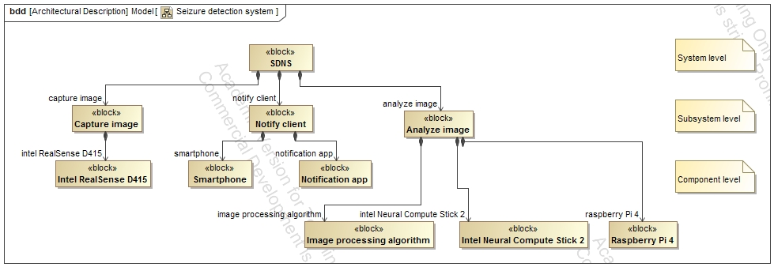
System Architecture
System is organized in a hierarchical architecture following the System Block Diagram and the logical flow down of functional requirements.
Notes:
Oanh
Present our system architecture so that sponsors and mentors can observe the various sub-systems and components that comprise the SDNS at a high level.
This slide demonstrates that we understand the functional requirements enough to flow them down to the component level so that we can define subsystems and components necessary for the operation of the system, and organize them in a logical hierarchy. This connects with our first objective in slide 3.

Slide 12
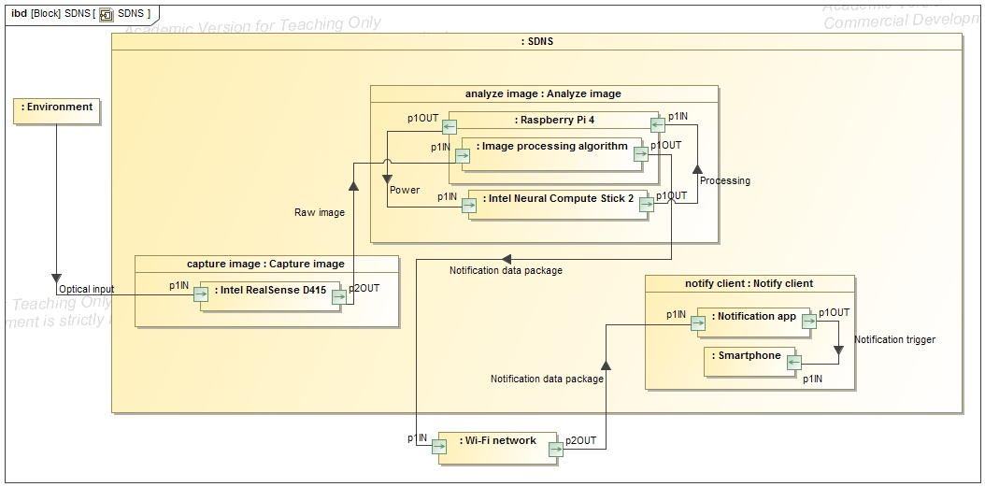
Final System Block Diagram
Proposed system block diagram to be reached at FAR.
Notes:
Juan
Present the system block diagram to show how the different subsystems and components are connected and how they work together at a high level. Start with the overarching SBD, this gives context for the rest.
With this slide, we demonstrate our understanding of the system as a set of connected subsystems that communicate in a specific way to achieve the desired task. Subsystems were defined from our functional requirements and ConOps, which demonstrates how our high-level understanding of the system slowly flows down to the sub-system level. This connects with our first objective on slide 3

Slide 13
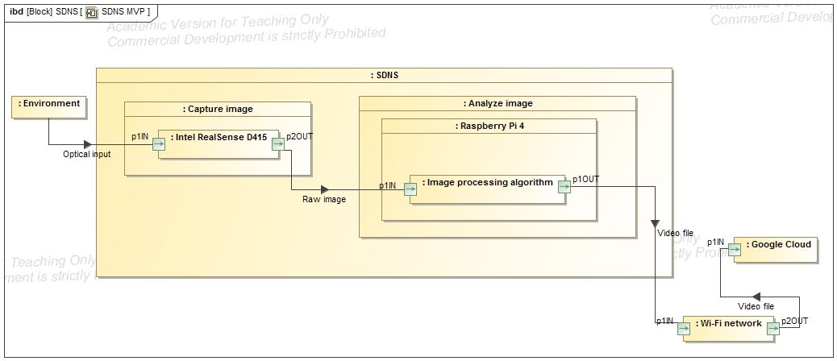
System Block Diagram for MVP
The MVP system is comprised of subsystems based on data collection requirements.
Notes:
Juan
Present the system block diagram to show how the different subsystems and components are connected and how they work together at a high level. Start with the overarching SBD, this gives context for the rest.
With this slide, we demonstrate our understanding of the system as a set of connected subsystems that communicate in a specific way to achieve the desired task. Subsystems were defined from our functional requirements and ConOps, which demonstrates how our high-level understanding of the system slowly flows down to the sub-system level. This connects with our first objective on slide 3

Slide 14
System Requirements & SRVM
System Requirement | Subsystem Requirement | Verification | Component
SR1.1: The system shall capture images at a rate above 16 FPS. | 1.1.1: The system shall capture RGB images at a resolution of at least 640x480 pixels | I | RealSense Camera
 | 1.1.2: The system shall capture RGB images at a rate of at least 16 FPS. | T | RealSense Camera
 | 1.1.3: The system shall create a depth map at a resolution of at least 640x480 pixels. | T | RealSense Camera
 | 1.1.4: The system shall capture a depth map at a rate of at least 16 FPS. | T | RealSense Camera
 | 1.1.5: The system shall be able to save the images and depth maps captured. | I | Software
Doc:102,000

Slide 15
System Requirements & SRVM
System Requirement | Subsystem Requirement | Verification | Component
SR1.2: The system shall perform steady-state processing at rate above 16 FPS. | 1.2.1: The system shall perform the motion detection algorithm at rate of at least 16 FPS. | T | Software
SR1.3: The system shall detect a seizure with at least 90 percent accuracy. | 1.3.1: The system shall detect motion on data from the Image Capture subsystem. | T | Software
 | 1.3.2: The system shall detect motion through a bedsheet. | T | Software
Doc:105,100

Slide 16
System Requirements & SRVM
System Requirement | Subsystem Requirement | Verification | Component
SR1.5: The system shall operate independently from the presence of visible light, in room-ambient conditions. | 1.5.1: The Image Capture subsystem shall be able to gather relevant data in low light conditions. | T | RealSense Camera
 | 1.5.2: The Image Capture subsystem shall operate in room-ambient conditions | I | RealSense Camera
 | 1.5.3: The Image Analysis subsystem shall operate in room-ambient conditions | I | Hardware
Doc:105,100

Slide 17
CDR Overview
Introduction
Changes Since PDR
PDR Action Items
Requirements Review
System Block Diagrams
System Architecture
System Requirements and SRVM
MVP Definition
Prioritized Requirements
MVP Prototyping Complete
MVP Verification Complete
Analysis and Predictions
Agile Management Process
Configuration Management
Project Plan
Next Design Steps
Expected Design for ISR
Risk Analysis
Cost Analysis
Project Deliverables
Summary

Slide 18
MVP Definition
MVP definition was chosen based on the need to obtain real-world training data and the critical technology of detecting motion through bedsheets.
These system requirements define what the minimum viable product shall be because it will allow us to use a depth camera (1.1) to gather and process training data (1.2, 1.3) while operating under dark or illuminated conditions at room-ambient conditions (1.5)
1.1 | The system shall capture images at a rate above 16 fps.
1.2 | The system shall perform steady-state processing at rate above 16 fps.
1.3 | The system shall detect a seizure with at least 90 percent accuracy
1.5 | The system shall operate independently from the presence of visible light, in room-ambient conditions.
Our MVP was well-defined by requirements that allowed us to
improve our critical technology and reduce risk.
Notes:
Alejandro
Here the plan is to show what we considered when coming up with our design based on the requirements from our sponsors, our skill set as engineers, the environment and user of the system, and how those considerations lead our design and trade studies process
This slide presents the considerations we took prior starting the design and trade studies for our system. This demonstrates our understanding of the goals and limitations of our project and connects with our first objective in slide 3.
Considerations:
Maximize reliability of detection and notification
Maximize cost effectiveness (Budget)
Improve quality of life of patient
Open source
Limitations:
Darkness, bedsheets
Access to training data
Computation power at the edge

Slide 19
MVP Definition
Our expectations are:
Collect data about motion during sleep of epileptic patients for training the seizure detection algorithm.
Characterize biomarkers that will aid for the development of our seizure detection algorithm.
Validate our method to collect clinical data while protecting patient’s privacy.
Value added to the project:
Tackle the first obstacle of detecting motion of a patient under a bed sheet in the dark (refinement of the algorithm will lead us to detecting a seizure)
Algorithm is inferencing based on real data instead of synthetic data
We can export information generated in the local processing unit (RPi4) which helps towards the development of the alarm system (exporting a decision made on the computer to an alerting interface (phone))
The MVP as defined will collect real training data that will
help refine our seizure detection algorithm.

Slide 20
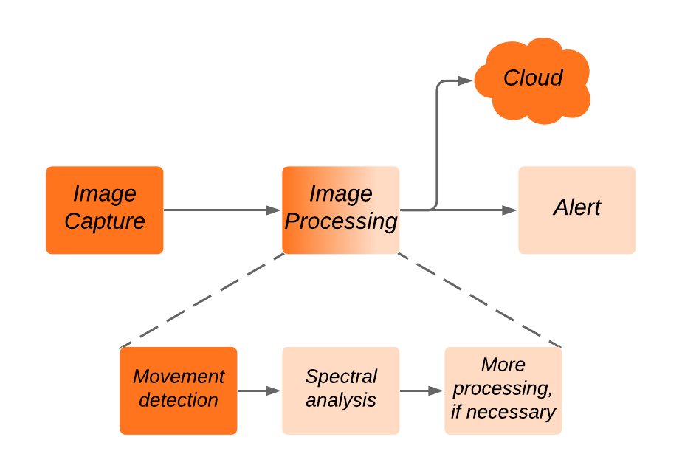
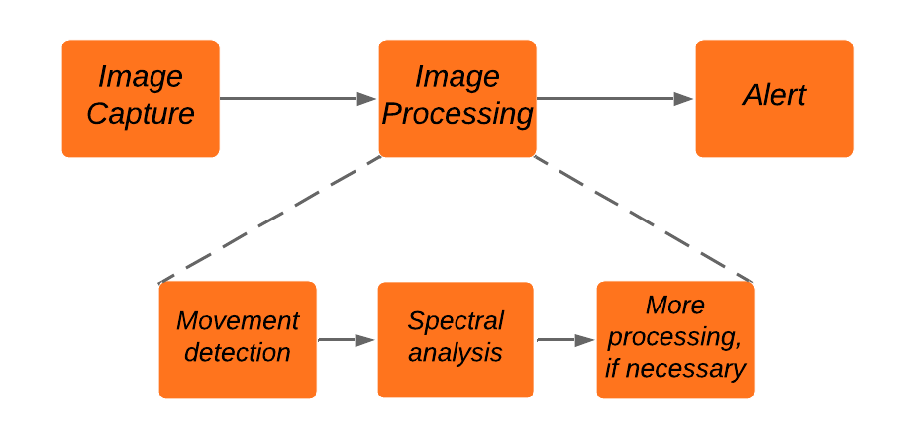
MVP Definition
Final SDNS
MVP SDNS
Orange depicts functions to be completed for each respective phase.
The MVP includes a critical subset of the final SDNS features
Notes:
Gordon
-Stretch goal of alarm to notify medication need.
-This slide shows what parts of the system that the MVP covers; they give a visual for the MVP definition and they give context for the MVP within the final system

Slide 21
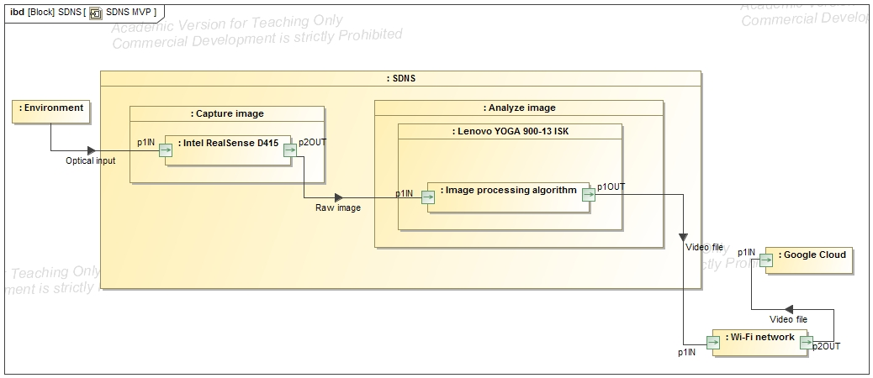
As Built MVP
The as-built MVP is processing through a Lenovo laptop instead of R-Pi4.
Notes:
drawings
software
models
performance
demo?

Slide 22
Changes from MVP Definition
We have completed our MVP prototyping
System was built as planned with minor changes regarding interface and data collection algorithm (refer to slide 6) and a different component (Lenovo Yoga 900-13ISK):
Changed 10 minute snippets to 5 minute snippets to reduce file size.
Changed how motion is detected: 5 minute video is captured, then analyzed looking for motion to decide if video should be uploaded to cloud or deleted.
The as-built design is presented with minor changes from the as-planned design in order to make files more manageable. Component change for the computer to proceed with testing was necessary
Notes:
MVP prototyping complete
This and next few slides will have software diagrams, pictures of device in test setup that collectively describe the MVP as-built
As-planned vs as-built pointed out when there is a discrepancy, with rationale for the change

Slide 23
Changes from MVP Definition
MVP as-planned included Raspberry Pi 4B as a component part of the image analysis subsystem.
Unexpected issues with compatibility of a core library that manages the use of the RealSense Camera did not allow for testing in the device
Tests were made on a Lenovo Yoga 900-13ISK Running Windows 10
GPIO Buttons could not be tested due to a compatibility issue with the GPIO library and the Raspberry Pi 4.
We incurred into compatibility issues that affected this delivery, but not our Final System

Slide 24
Gathering Real Clinical Data for MVP
Research protocol has been built to describe how the data collection will be done in the clinic (refer to Clinical Investigation Protocol V1):
Patient selection based on pre-existing condition
Criteria based on occurence of tonic-clonic seizures as diagnosed by medical professional
Patient debriefing
Explanation of nature of research, rights of the patient, opt-out procedure, objectives, etc
Agreement of use of information between the patient, research team and clinical facilities
Contains important information about the life-cycle of the data.
Installation of equipment in medical facilities
Data collection
Collection of systems at the end of the project
A research protocol document has been created for the formalization of our clinical trial as well for the debriefing of the patients that agree to participate in our study

Slide 25
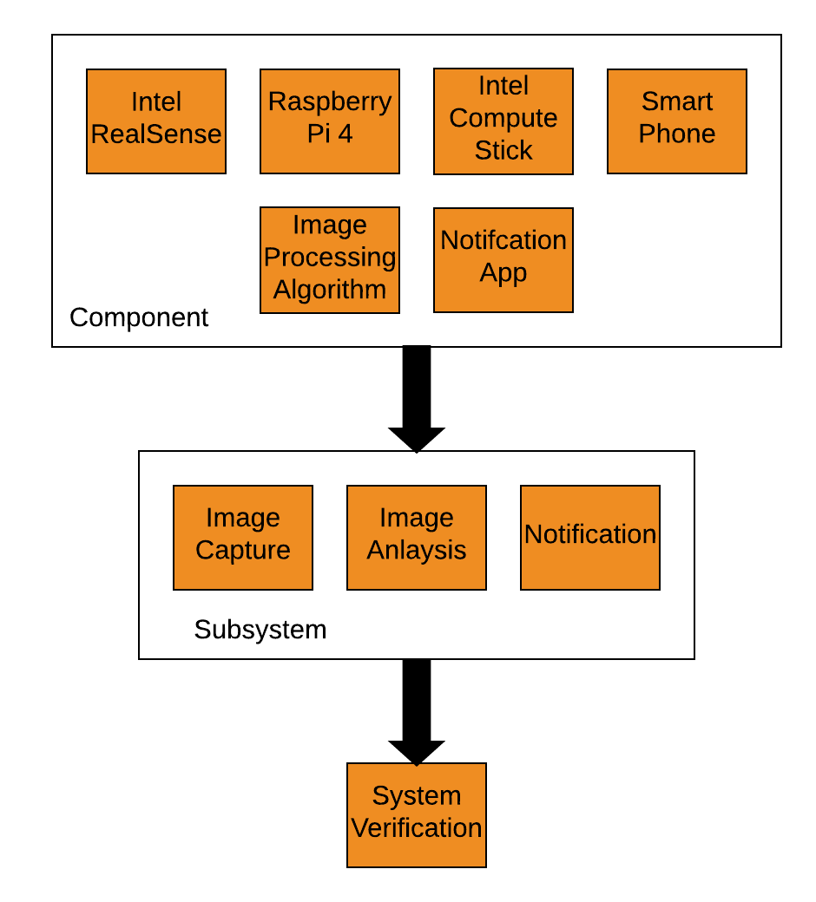
MVP Verification
Final verification will start at component level, and work up to final integration testing
Doc:103,00
Notes:
Alejandro
Here the plan is to show what we considered when coming up with our design based on the requirements from our sponsors, our skill set as engineers, the environment and user of the system, and how those considerations lead our design and trade studies process
This slide presents the considerations we took prior starting the design and trade studies for our system. This demonstrates our understanding of the goals and limitations of our project and connects with our first objective in slide 3.
Considerations:
Maximize reliability of detection and notification
Maximize cost effectiveness (Budget)
Improve quality of life of patient
Open source
Limitations:
Darkness, bedsheets
Access to training data
Computation power at the edge

Slide 26
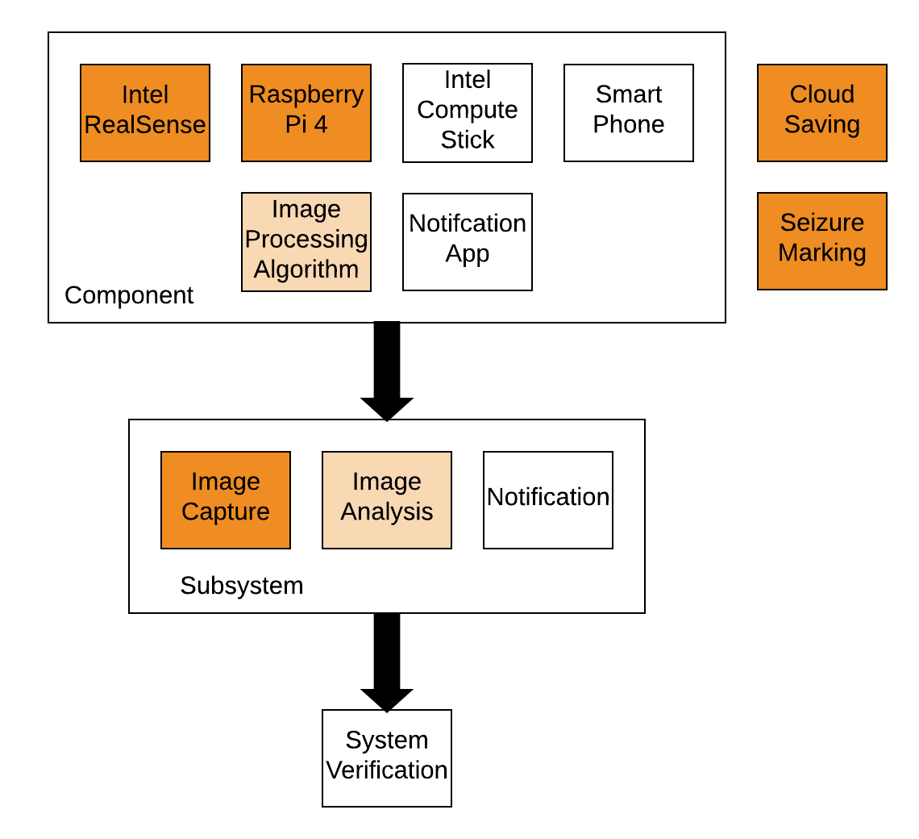
MVP Verification
The complete Image Capture Subsystem is verified for the MVP
Only the motion detection algorithm part of Image Processing component is implemented for the MVP
The additional, MVP-only functions of cloud saving and seizure marking were also verified for the MVP
Only the basic image analysis functions are featured in the MVP, just enough to allow us to collect real data.
Doc:103,00

Slide 27
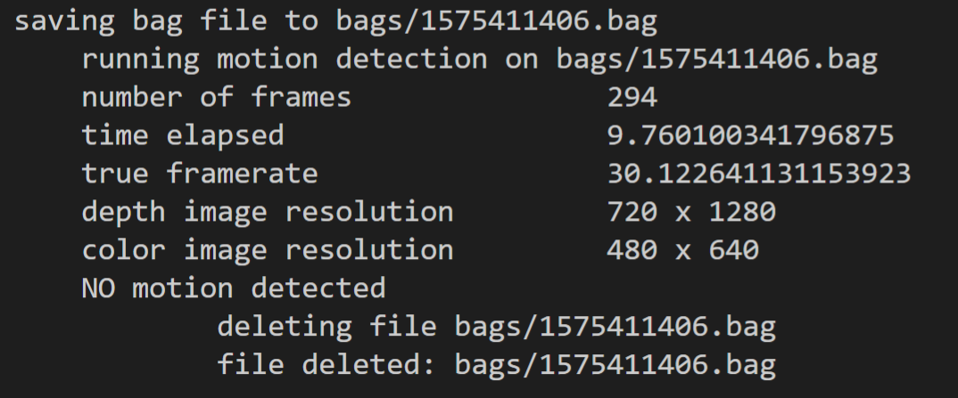
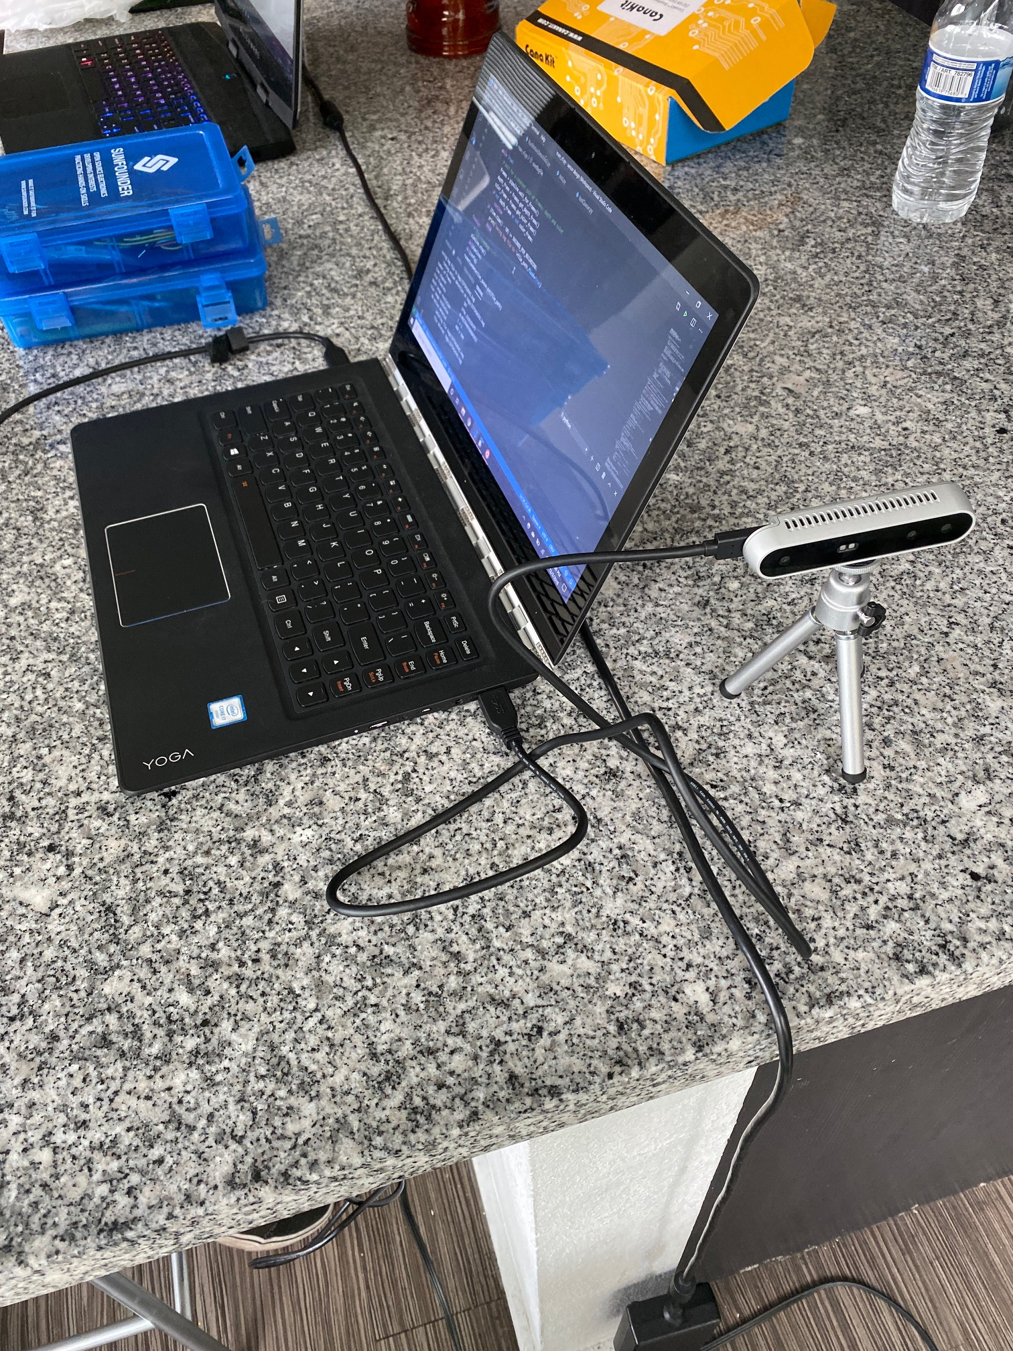
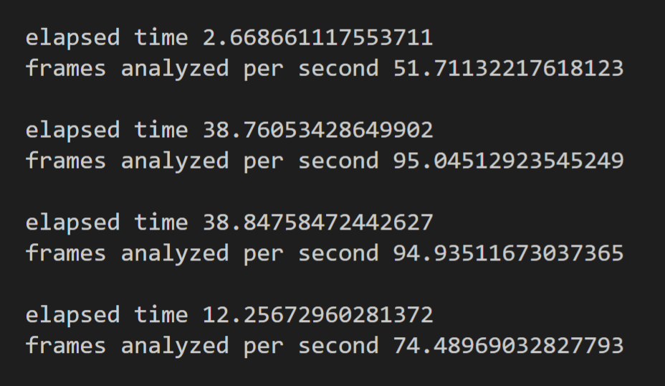
MVP Testing

Slide 28
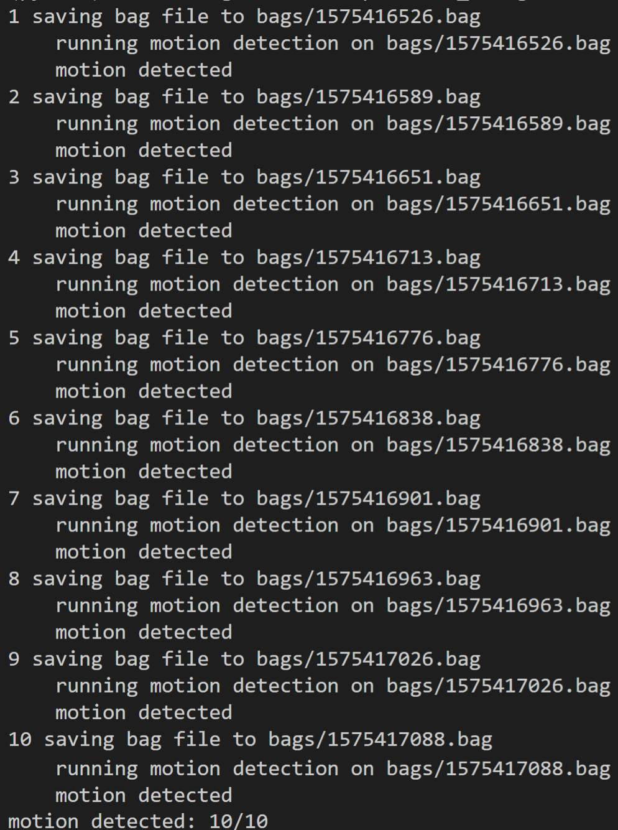
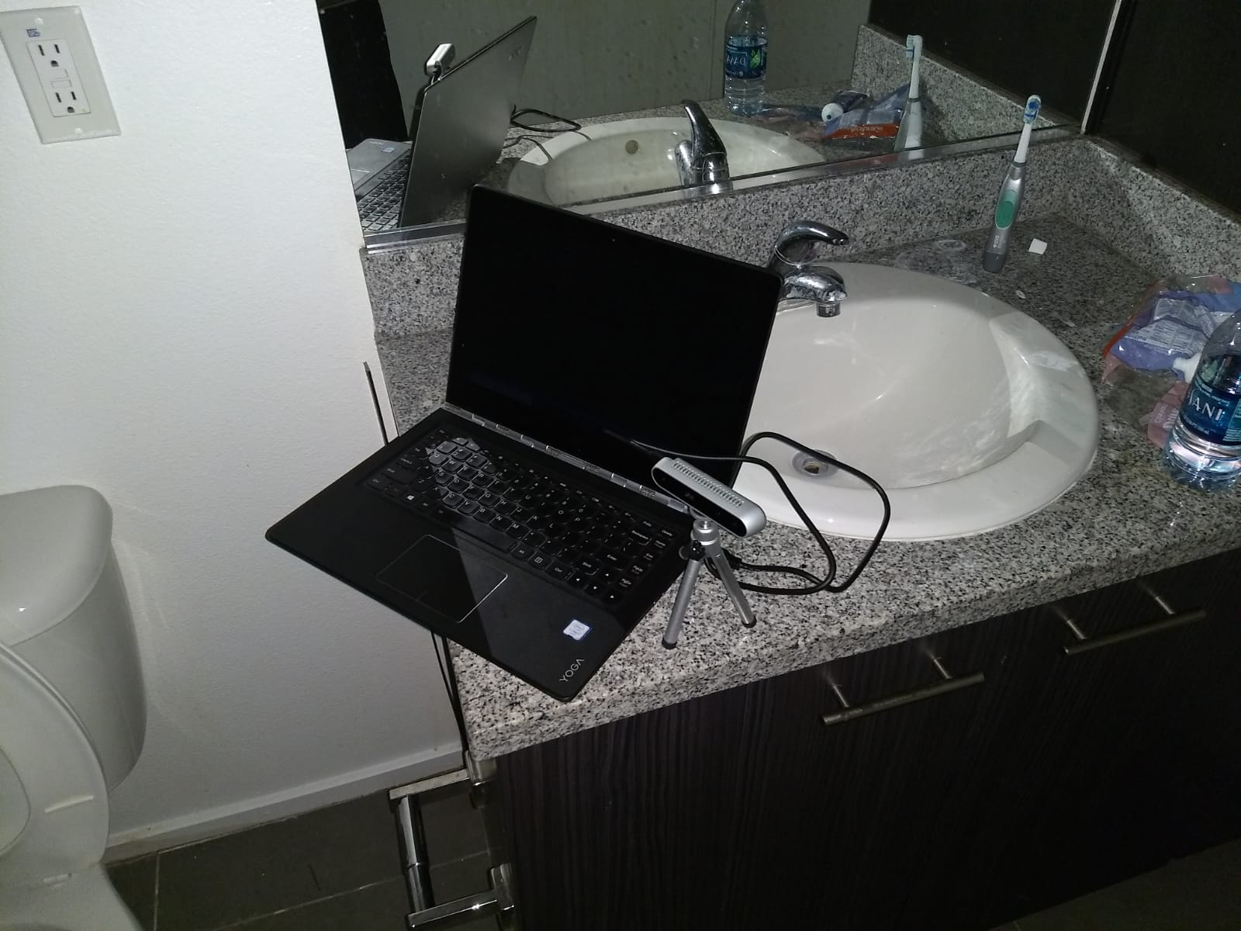
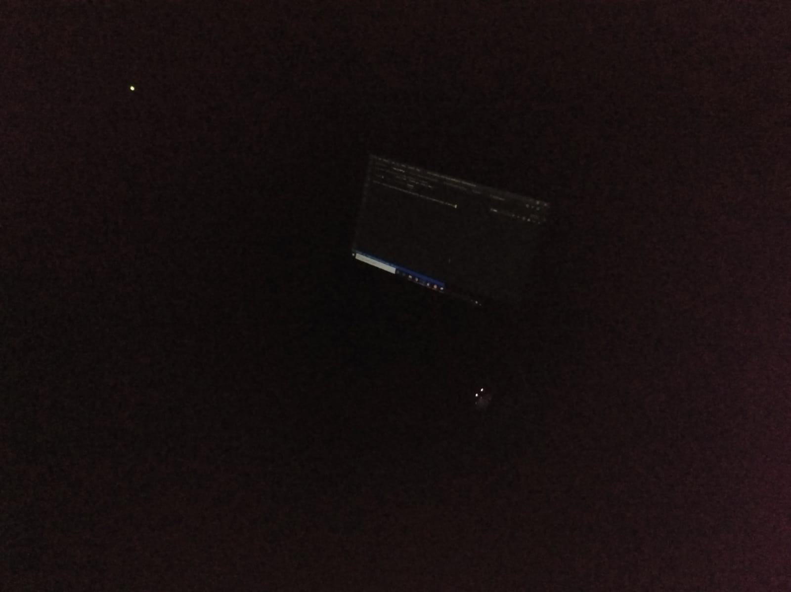
MVP Testing

Slide 29
MVP Verification: Image Capture
SSR1.1.1: The system shall capture RGB images at a resolution of at least 640x480 pixels
Verification: Inspection
Method: Check that the images captured meet the resolution requirement
Target Value: 640 by 480 pixels
Recorded Value: 640 by 480 pixels
Pass/Fail: PASS
Conclusions: RGB camera operates with sufficient resolution to flag seizures in training data
Doc:103,00

Slide 30
MVP Verification: Image Capture
SSR1.1.2: The system shall capture RGB images at a rate of at least 16 FPS.
Verification: Test
Method: Set up the RealSense with image capture software on the RPi4 per test procedure Img_Cap_T1 using the image capture software (106,100) to count frames captured per second.
Target Value: >=16 FPS
Recorded Value: 30.12 FPS
Pass/Fail: PASS
Conclusions: RGB camera operates at a sufficient frame rate to flag seizures in training data
Doc:103,00

Slide 31
MVP Verification: Image Capture
SSR1.1.3: The system shall create a depth map of at least 640 by 480 pixels.
Verification: Inspection
Method: Check that the depth map captured meet the resolution requirement
Target Value: 640x480 pixels
Recorded Value: 1280x720 pixels
Conclusions: Depth camera operates with a sufficient resolution to detect seizures
Doc:103,000

Slide 32
MVP Verification: Image Capture
SSR1.1.4:The system shall capture a depth map at a rate of at least 16 FPS.
Verification: Test
Method: Set up the RealSense with image capture software on the laptop per test procedure Img_Cap_T2 using the image capture software (106,100) to count frames captured per second.
Target Value: >=16 FPS
Recorded Value: 30.12 FPS
Pass/Fail: PASS
Conclusions: Depth camera operates at a sufficient framerate to detect seizures
Doc:103,000

Slide 33
MVP Verification: Image Capture
SSR1.1.5: The system shall be able to save the images and depth maps captured.
Verification: Inspection
Method: Check that the system saves can save files to the hard drive
Pass/Fail: PASS
Conclusions: System successfully saves .bag files that contain the images and depth maps to the hard drive
Doc:103,000

Slide 34
MVP Verification: Image Capture
SSR1.5.1: The Image Capture subsystem shall be able to gather relevant data in low light conditions.
Verification: Test
Method: Set up the RealSense with image capture and analysis software on the laptop per test procedure Img_Cap_T3. The tester will ensure the images captured are sufficient for analysis.
Target Value: 10/10
Recorded Value: 10/10
Pass/Fail: PASS
Conclusions: The motion detection algorithm successfully detected motion every time it was tested in low light conditions
Doc:103,000

Slide 35
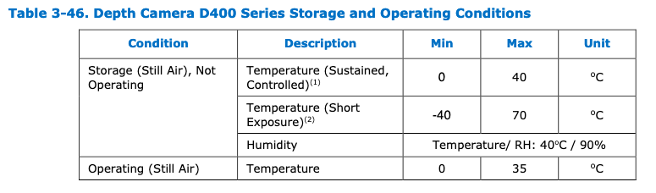
MVP Verification: Image Capture
SSR1.5.2: The Image Capture subsystem shall operate in room-ambient conditions
Verification: Inspection
Method: Check Intel RealSense Data Sheet 337029-007 for operational temperature range 70 ± 3 °F (21.11 ± ˜1.6 °C)
Pass/Fail: Pass
Doc:103,000

Slide 36
MVP Verification: Image Analysis
SSR1.2.1:The system shall perform the motion detection algorithm at rate of at least 16 FPS.
Verification: Test
Method: Set up the RealSense with image capture (106,100) and analysis software on the laptop per test procedure Img_Ana_T1 using the Motion Detection Software (106,200) software to count frames analyzed per second.
Target Value: >=16 FPS
Recorded Value: 79 FPS (average)
Pass/Fail: PASS
Conclusions: Frame rate of processing is variable but sufficient for the motion detection to process faster than videos are recorded
Doc:103,000

Slide 37
MVP Verification: Image Analysis
SSR1.3.1:The system shall detect motion on data from the Image Capture subsystem.
Verification: Test
Method: Set up the RealSense with image capture (106,100) and analysis software (106,200) on the laptop per test procedure Img_Ana_T2. The tester will track how many times the system correctly detects motion when expected.
Target Value: 10/10
Recorded Value: 10/10
Pass/Fail: PASS
Conclusions: Image analysis subsystem succesfully detected motion every time it was tested independent from conditions
Doc:103,000

Slide 38
MVP Verification: Image Analysis
SSR1.3.2: The system shall detect motion through a bedsheet.
Verification: Test
Method: Set up the RealSense with image capture (106,100) and analysis software (106,200) on the laptop per test procedure Img_Ana_T3. The tester will track how many times the system correctly detects motion when expected.
Target Value: 10/10
Recorded Value: 10/10
Pass/Fail: PASS
Conclusions: The image analysis subsystem identified motion under the sheets every time it was tested
Doc:103,000

Slide 39
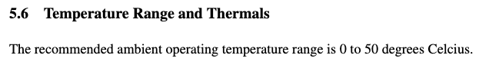
MVP Verification: Image Capture
SSR1.5.3: The Image Capture subsystem shall operate in room-ambient conditions
Verification: Inspection
Method: Check Raspberry Pi 4 Data Sheet Release 1 for operational temperature range 70 ± 3 °F (21.11 ± ˜1.6 °C)
Pass/Fail: Pass
Doc:103,000

Slide 40
MVP Verification: GPIO
The MVP will have GPIO Buttons to tag seizure events.
Verification: Test
Method: Set up the RealSense with image capture software (106,100) and image analysis software (106,200) on the RPi4 per test procedure MVP_T1. The tester will compare time the button was pressed with time recorded.
Target Value: 10/10
Recorded Value: 0/10
Pass/Fail: FAIL
Conclusions: The GPIO buttons could not be tested due to compatibility issues with existing libraries
Doc:103,000

Slide 41
MVP Verification: Cloud Upload
The MVP will automatically save files to the cloud.
Verification: Inspection
Method: Verify that files where motion is detected are successfully saved to Drive.
Pass/Fail: Pass
Conclusions: The MVP has a script that successfully uploads files to the Team Leader Google Drive without corruption of data.

Slide 42
MVP Verification: Mount
In order to observe patients in clinical trial the MVP needs to be mounted above the patients bed
We are still waiting on information from the hospital regarding the rooms the MVP will operate in
Until we receive that information we cannot verify this requirement

Slide 43
MVP Verification
Requirement # | Requirement Title | Verification Method | Required Value | Units | Oper-ation | Actual Value | Pass/ Fail | Margin
SR1.1 | Image Requirement | Test | 16 | FPS | >= | 30.12 | pass
SSR1.1.1 | Image Resolution | Inspection | 640x480 | pixel | >= | 640x480 | pass
SSR1.1.2 | Image FPS | Test | 16 | FPS | >= | 30.12 | pass | N/A
SSR1.1.3 | IR Resolution | Inspection | 640x480 | pixel | >= | 1280x720 | pass
SSR1.1.4 | IR Rate | Test | 16 | FPS | >= | 30.12 | pass | N/A
SSR1.1.5 | Save Images | Inspection | True | logic | bool | True | pass
Requirements Verification Table shows that our required values have been met for the MVP
Doc:104,000

Slide 44
MVP Verification
Requirement # | Requirement Title | Verification Method | Required Value | Units | Oper-ation | Actual Value | Pass/ Fail | Margin
SR1.2 | Image Processing | Test | 16 | FPS | >=
SSR1.2.1 | Motion Rate | Test | 16 | FPS | >= | 79 | PASS | N/A
SR1.3 | Detection Accuracy | Test/Analysis | 90 | % | >=
SSR1.3.1 | Capture to Analysis | Test | 10 | YES | = | 10 | PASS | N/A
SSR1.3.2 | Bedsheet | Test | 10 | YES | = | 10 | PASS | N/A
Requirements Verification Table shows that our required values have been met for the MVP
Doc:104,000

Slide 45
MVP Verification
Requirement # | Requirement Title | Verification Method | Required Value | Units | Oper-ation | Actual Value | Pass/ Fail | Margin
SSR1.5.1 | Low Light | Test | 10 | YES | = | 10 | PASS
SSR1.5.2 | Image Capture Room Ambient | Inspection | 21.11 +/- 1.6 | °C | Include | 0 to 35 | PASS
SSR1.5.3 | Image Analysis Room Ambient | Inspection | 21.11 +/- 1.6 | °C | Include | 0 to 50 | PASS
Requirements Verification Table shows that our required values have been met for the MVP
Doc:104,000

Slide 46
MVP Verification
Requirement # | Requirement Title | Verification Method | Required Value | Units | Oper-ation | Actual Value | Pass/ Fail | Margin
N/A | GPIO Buttons | Test | 10 | YES | = | 0 | FAIL
N/A | Cloud Saving | Inspection | True | Logic | bool | True | PASS
N/A | Mounting | Inspection |  |  |  |  | FAIL
MVP Specific functionality was of cloud saving is verified, but GPIO buttons and mounting could not be.

Slide 47
MVP Conclusion
All software and camera hardware was successfully tested and verified.
At the component level, Raspberry Pi 4 showed unexpected compatibility issues that prevented full testing as expected.
This does not mean that this component is unviable, it requires lower level troubleshooting which will be done with the help of our sponsor.
GPIO buttons are to be tested once compatibility issues have been resolved.
Mounting system was not able to be verified at this time as we are still awaiting confirmation of the environment it will be mounted

Slide 48
CDR Overview
Introduction
Changes Since PDR
PDR Action Items
Requirements Review
System Block Diagrams
System Architecture
System Requirements and SRVM
MVP Definition
Prioritized Requirements
MVP Prototyping Complete
MVP Verification Complete
Analysis and Predictions
Agile Management Process
Configuration Management
Project Plan
Next Design Steps
Expected Design for ISR
Risk Analysis
Cost Analysis
Project Deliverables
Summary

Slide 49
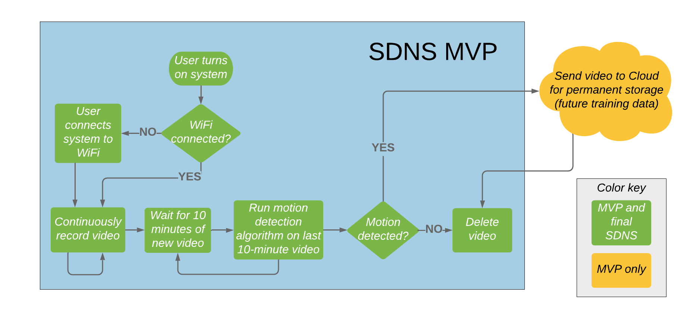
Models & Analyses
Our MVP software model has been implemented as above.
Notes:
Gordon
SDNS MVP in grey, “MVP and final SDNS” in green, “MVP only” in yellow, “color key” in grey

Slide 50
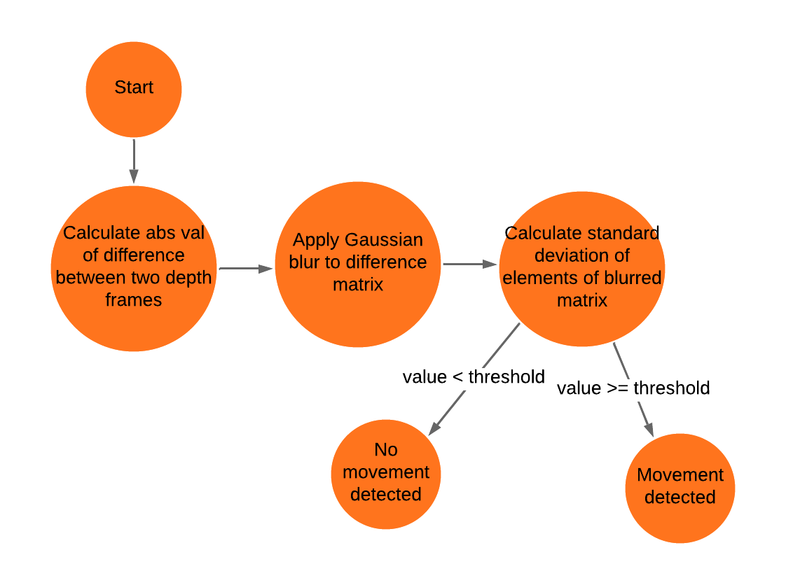
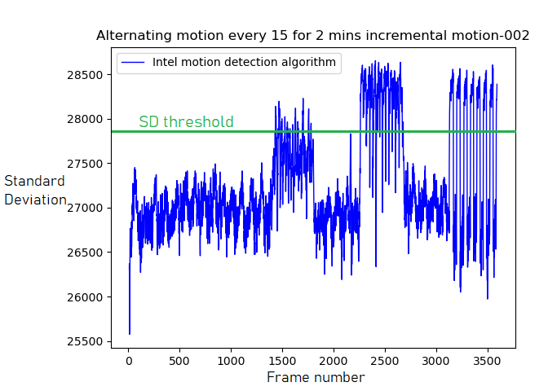
Models & Analyses
Improved motion detection algorithm
We have a robust, state-of-the-art movement detection algorithm implemented.
Doc:105,200
Notes:
Gordon
-Stretch goal of alarm to notify medication need.

Slide 51
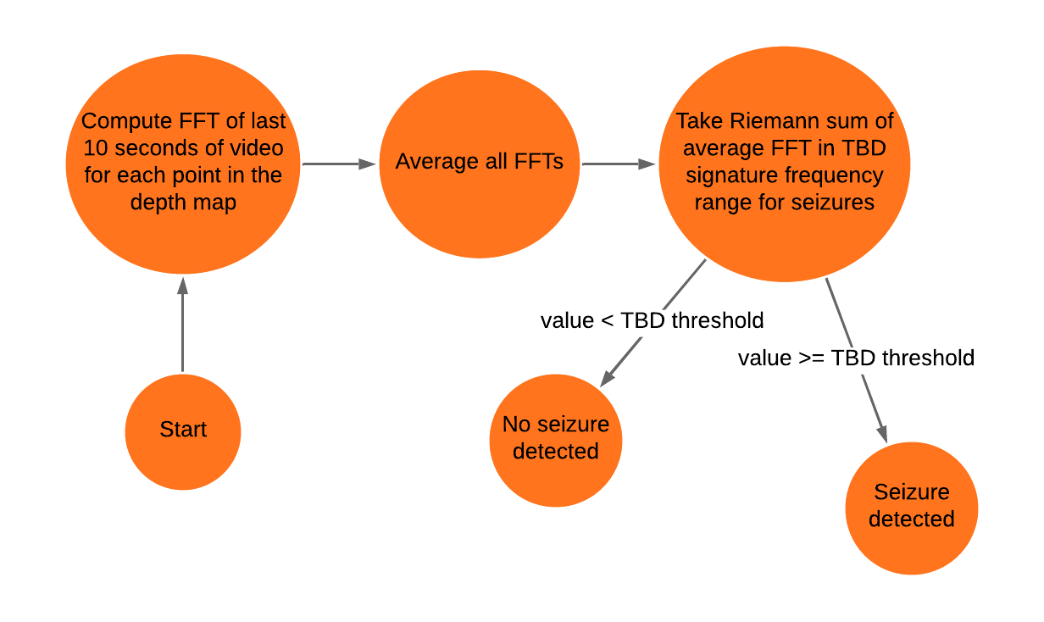
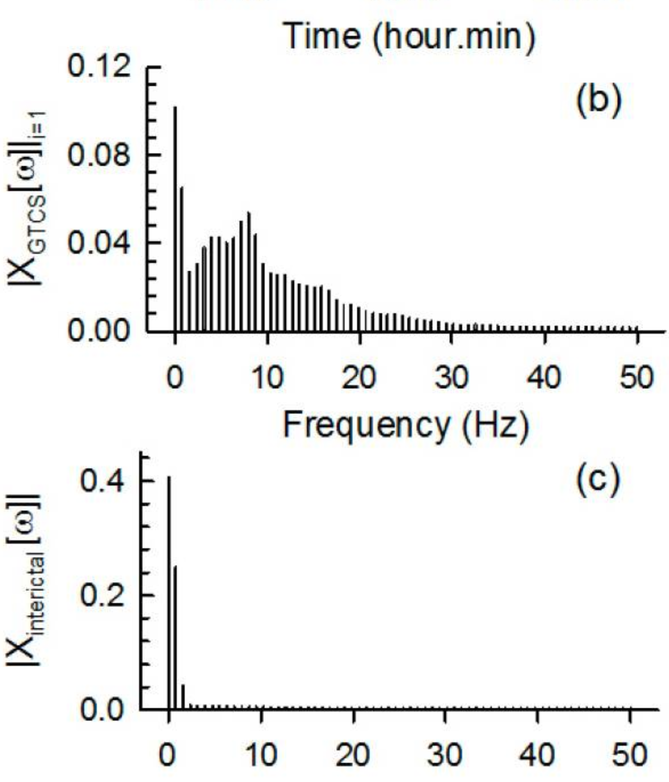
Models & Analyses
Seizure detection algorithm
We have a strong seizure detection algorithm ready to develop further.
Doc:105,300
Notes:
Gordon
-Stretch goal of alarm to notify medication need.

Slide 52
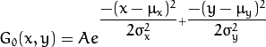
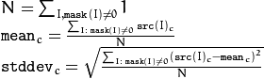
Analysis and Predictions
Motion detection algorithm using CPU:
Inputs: 2 depth images: WxH = 1280x720 matrices of 16-bit integers
Output: boolean, whether motion was detected
dist = abs( depth_image1 - depth_image2 )
2 * H * W
mod = GaussianBlur( dist, (B,B) )
3 * B² * H * W, assuming kernel is computed only once
return standard_deviation( mod ) > threshold
3 * H * W
total: (3B² + 5)HW operations per frame comparison
with B = 9, H = 720, W = 1280:
total: (3*9² + 5)720*1280 = 228,556,800 ~= 229M operations per frame comparison
With RPi model 4B Quad core Cortex-A72 (ARM v8) 64-bit SoC @ 1.5GHz (https://www.raspberrypi.org/products/raspberry-pi-4-model-b/specifications/),
can do 1.5G / 229M = 6.55 frame comparisons per second maximum using only one core
Tests have shown that 3 frame comparisons per second is sufficient, meaning motion detection algorithm is occupying 229M * 3 / 1.5G = 45.8% of one of four cores
Using less than half of the resources of one core of the RPi CPU, we can run the motion detection algorithm as fast as will be needed.
Doc:105,100
Notes:
Alejandro
Here the plan is to show what we considered when coming up with our design based on the requirements from our sponsors, our skill set as engineers, the environment and user of the system, and how those considerations lead our design and trade studies process
This slide presents the considerations we took prior starting the design and trade studies for our system. This demonstrates our understanding of the goals and limitations of our project and connects with our first objective in slide 3.
Considerations:
Maximize reliability of detection and notification
Maximize cost effectiveness (Budget)
Improve quality of life of patient
Open source
Limitations:
Darkness, bedsheets
Access to training data
Computation power at the edge

Slide 53
Analysis and Predictions
Seizure detection algorithm using CPU:
Input: last T seconds of video (30T frames) Assume T = 8.5 seconds
Output: boolean, whether seizure was detected
FFT of last T seconds -> 30T frames
With T = 8.5, 30T = 255 frames. Round up to 256 and with split radix you have: 1284 + 5380 = 6664 operations per FFT (http://www.cmlab.csie.ntu.edu.tw/cml/dsp/training/coding/transform/fft.html)
6664 * H * W operations
Sum all elements
256 * H * W operations
return ( (Riemann sum of elements in a certain range) > threshold )
less than 200 operations
Total: ~ 6920HW operations per run of algorithm
With H = 720, W = 1280, T = 8.5: 6920 * 720 * 1280 = 6,377,472,000 ~= 6.4G operations per algorithm run
With RPi model 4B Quad core Cortex-A72 (ARM v8) 64-bit SoC @ 1.5GHz (https://www.raspberrypi.org/products/raspberry-pi-4-model-b/specifications/)
can run the seizure detection algorithm 1.5G / 6.4G = 0.2344 times per second = every 4.267 seconds maximum, using only one core
So, we can run the seizure detection algorithm approximately once every 4.267 seconds, using a FFT window of the last 8.5 seconds of video each time using only one core of the RPi
Using one core of the RPi CPU, we can run the seizure detection algorithm at a sufficiently fast rate and with a reasonable FFT time window.
Doc:105,100
Notes:
Alejandro
Here the plan is to show what we considered when coming up with our design based on the requirements from our sponsors, our skill set as engineers, the environment and user of the system, and how those considerations lead our design and trade studies process
This slide presents the considerations we took prior starting the design and trade studies for our system. This demonstrates our understanding of the goals and limitations of our project and connects with our first objective in slide 3.
Considerations:
Maximize reliability of detection and notification
Maximize cost effectiveness (Budget)
Improve quality of life of patient
Open source
Limitations:
Darkness, bedsheets
Access to training data
Computation power at the edge

Slide 54
Analysis and Predictions
Motion detection algorithm using GPU:
Inputs: 2 depth images: WxH = 1280x720 matrices of 16-bit integers
Output: boolean, whether motion was detected
dist = abs( depth_image1 - depth_image2 )
2
mod = GaussianBlur( dist, (B,B) )
at most B * B
return standard_deviation( mod ) > threshold
H * W + 2
total: B² + HW + 4 GPU clock cycles per frame comparison
with B = 9, H = 720, W = 1280:
total: (9² + 720*1280 + 4) = 921,685 ~= 930K GPU clock cycles per frame comparison
With RPi model 4B VideoCore 6 GPU @500 MHz (https://www.raspberrypi.org/forums/viewtopic.php?t=244519)
can run the seizure detection algorithm 500M / 930K = 542 times per second >> 30 Hz camera rate
Using the RPi GPU, we can run the motion detection algorithm as often as we might want.
Doc:105,100
Notes:
Alejandro
Here the plan is to show what we considered when coming up with our design based on the requirements from our sponsors, our skill set as engineers, the environment and user of the system, and how those considerations lead our design and trade studies process
This slide presents the considerations we took prior starting the design and trade studies for our system. This demonstrates our understanding of the goals and limitations of our project and connects with our first objective in slide 3.
Considerations:
Maximize reliability of detection and notification
Maximize cost effectiveness (Budget)
Improve quality of life of patient
Open source
Limitations:
Darkness, bedsheets
Access to training data
Computation power at the edge

Slide 55
Analysis and Predictions
Seizure detection algorithm using GPU:
Input: last T seconds of video (30T frames) Assume T = 8.5 seconds
Output: boolean, whether seizure was detected
FFT of last T seconds -> 30T frames
With T = 8.5, 30T = 255 frames. Can perform one FFT in a single clock cycle of the GPU
H * W GPU clock cycles
Sum all elements
256 GPU clock cycles
return ( (Riemann sum of elements in a certain range) > threshold )
less than 200 operations
Total: ~ HW + 500 GPU clock cycles per run of algorithm
With H = 720, W = 1280, T = 8.5: 720 * 1280 + 500 = 922,100 ~= 9.3K GPU clock cycles per algorithm run
With RPi model 4B VideoCore 6 GPU @500 MHz (https://www.raspberrypi.org/forums/viewtopic.php?t=244519)
can run the seizure detection algorithm 500M / 9.3K = 53,763 times per second >> 30 Hz camera rate
Using the RPi GPU, we can run the seizure detection algorithm as often as we might want to, with any FFT time window we might want.
Doc:105,100
Notes:
Alejandro
Here the plan is to show what we considered when coming up with our design based on the requirements from our sponsors, our skill set as engineers, the environment and user of the system, and how those considerations lead our design and trade studies process
This slide presents the considerations we took prior starting the design and trade studies for our system. This demonstrates our understanding of the goals and limitations of our project and connects with our first objective in slide 3.
Considerations:
Maximize reliability of detection and notification
Maximize cost effectiveness (Budget)
Improve quality of life of patient
Open source
Limitations:
Darkness, bedsheets
Access to training data
Computation power at the edge

Slide 56
Analysis and Predictions
Analysis of Raspberry Pi’s throughput combined with our tests show that hardware is viable for the MVP purpose.
Software incompatibilities can be resolved with aid of a subject matter expert.
Data collection for the training of the Seizure Detection algorithm can be collected effectively.
The use of the GPU helps the algorithm run much more efficiently.
Our system and subsystem requirements have not changed due to MVP performance
Notes:
Alejandro
Here the plan is to show what we considered when coming up with our design based on the requirements from our sponsors, our skill set as engineers, the environment and user of the system, and how those considerations lead our design and trade studies process
This slide presents the considerations we took prior starting the design and trade studies for our system. This demonstrates our understanding of the goals and limitations of our project and connects with our first objective in slide 3.
Considerations:
Maximize reliability of detection and notification
Maximize cost effectiveness (Budget)
Improve quality of life of patient
Open source
Limitations:
Darkness, bedsheets
Access to training data
Computation power at the edge

Slide 57
CDR Overview
Introduction
Changes Since PDR
PDR Action Items
Requirements Review
System Block Diagrams
System Architecture
System Requirements and SRVM
MVP Definition
Prioritized Requirements
MVP Prototyping Complete
MVP Verification Complete
Analysis and Predictions
Agile Management Process
Configuration Management
Project Plan
Next Design Steps
Expected Design for ISR
Risk Analysis
Cost Analysis
Project Deliverables
Summary

Slide 58
Agile Management Process
Project has been using the AGILE methodology with 2 week sprints
At the beginning of each sprint, there is a scrum meeting in which the tasks to be completed are defined based on our goals for the next delivery
Communication between team members is done through a messaging group
Communication with sponsor is made through the Team Lead
JIRA tool is being used to manage and assign tasks in real-time
Tasks are created and uploaded in JIRA, where they have a sprint and/or epic assigned to them.
Team members can auto-assign a task if they decide to complete it
Tasks are assigned and prioritized at the beginning of each sprint by the scrum master after a general meeting
All team members should have assigned tasks in parallel to ensure proper and timely development of the multiple parts of the project
We understand the agile management process and how requirements should be prioritized. We explained what verification evidence will be provided and gave a plan for providing it.
Notes:
Alejandro
Here the plan is to show what we considered when coming up with our design based on the requirements from our sponsors, our skill set as engineers, the environment and user of the system, and how those considerations lead our design and trade studies process
This slide presents the considerations we took prior starting the design and trade studies for our system. This demonstrates our understanding of the goals and limitations of our project and connects with our first objective in slide 3.
Considerations:
Maximize reliability of detection and notification
Maximize cost effectiveness (Budget)
Improve quality of life of patient
Open source
Limitations:
Darkness, bedsheets
Access to training data
Computation power at the edge

Slide 59
Agile Management Process
CDR
SR 1.1: Capture images at ≥16 fps rate
1.5: Operate at desired light cond.
SSR 1.2.1: Detect motion at ≥16 fps rate
1.3.1: Detect motion
1.3.2: Detect motion through bed sheet
Requirements prioritized based on risk, to achieve MVP
Gradually improvements to achieve the final system
ISR
SR 1.2: Perform steady-state processing at ≥16 fps
2.2: Deliver alerts to users wiresely
3.1: Keep log file with seizure info
3.2: Output log file on command
SSR 2.1.1: Notification data package when motion detected
2.1.4: Trigger alarm with detected motion
FAR
SR 1.3: Detect seizure ≥90 % accuracy
2.1: Trigger alarm when seizure detected
2.3: Alarm triggered within 5 sec of seizure detected
1.4 Within 10 seconds of clonic phase
The MVP will evolve to include all system requirements and capabilities based on an agile process.
Notes:
Here we propose deliverables by each review date so that the sponsor can get a sight if the added value over time of the project and how the MVP will tangibly transform into the final system. This connects with our thesis statement by demonstrating comprehension of the project and it’s stages.

Slide 60
CDR Overview
Introduction
Changes Since PDR
PDR Action Items
Requirements Review
System Block Diagrams
System Architecture
System Requirements and SRVM
MVP Definition
Prioritized Requirements
MVP Prototyping Complete
MVP Verification Complete
Analysis and Predictions
Agile Management Process
Configuration Management
Project Plan
Next Design Steps
Expected Design for ISR
Risk Analysis
Cost Analysis
Project Deliverables
Summary

Slide 61
Configuration Management
The CDR report will feature the first releases of the Proposal, SRD, SVRM, Verification, and software
Up until this point we have managed document changes by keeping a folder of “Master” and “Work in Progress” documents
During class time we go over changes in the document and ensure the team is okay with the changes
All work between classes is done based on the Master documents so that we are all working from the same source
Software is handled in a similar way by doing all the work based on the latest version uploaded and labeled properly
We have a clear configuration management plan, current status and future plans have been explained, and the verification plan is aligned with documentation and configuration control.
Notes:
Alejandro
Here the plan is to show what we considered when coming up with our design based on the requirements from our sponsors, our skill set as engineers, the environment and user of the system, and how those considerations lead our design and trade studies process
This slide presents the considerations we took prior starting the design and trade studies for our system. This demonstrates our understanding of the goals and limitations of our project and connects with our first objective in slide 3.
Considerations:
Maximize reliability of detection and notification
Maximize cost effectiveness (Budget)
Improve quality of life of patient
Open source
Limitations:
Darkness, bedsheets
Access to training data
Computation power at the edge

Slide 62
CDR Overview
Introduction
Changes Since PDR
PDR Action Items
Requirements Review
System Block Diagrams
System Architecture
System Requirements and SRVM
MVP Definition
Prioritized Requirements
MVP Prototyping Complete
MVP Verification Complete
Analysis and Predictions
Agile Management Process
Configuration Management
Project Plan
Next Design Steps
Expected Design for ISR
Risk Analysis
Cost Analysis
Project Deliverables
Summary

Slide 63
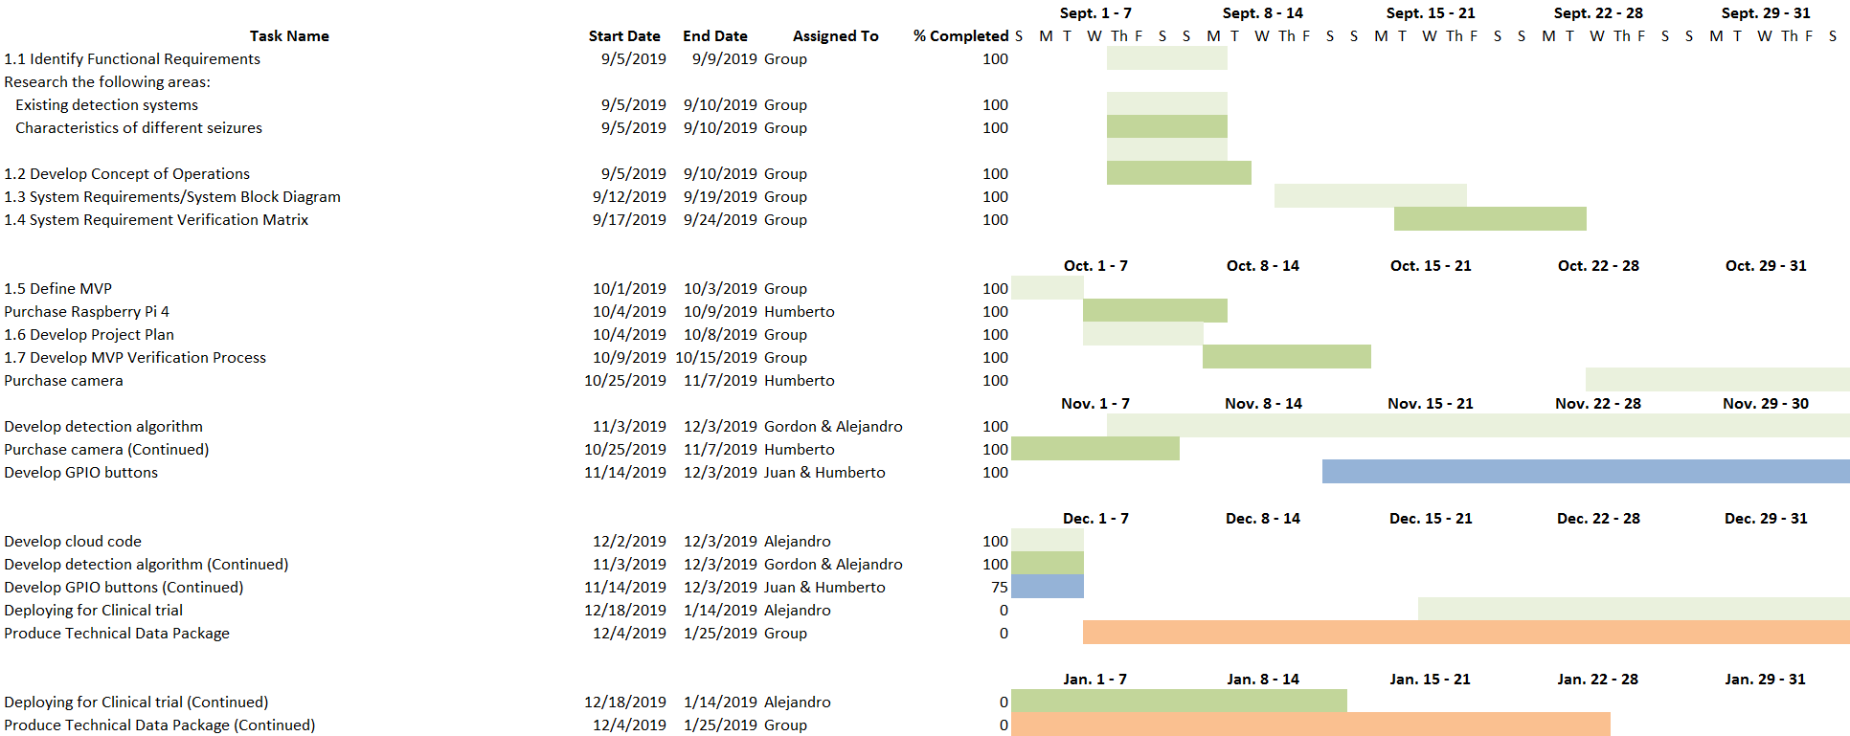
Project Plan
Project plan up until our TDP delivery.
Notes:
Alejandro
Here the plan is to show what we considered when coming up with our design based on the requirements from our sponsors, our skill set as engineers, the environment and user of the system, and how those considerations lead our design and trade studies process
This slide presents the considerations we took prior starting the design and trade studies for our system. This demonstrates our understanding of the goals and limitations of our project and connects with our first objective in slide 3.
Considerations:
Maximize reliability of detection and notification
Maximize cost effectiveness (Budget)
Improve quality of life of patient
Open source
Limitations:
Darkness, bedsheets
Access to training data
Computation power at the edge

Slide 64
Project Plan
We have used the advancement of our critical technology as our driving force for the next MVP to be delivered at ISR and used system requirements to define it.
SSR1.2.3 | The system shall perform the seizure detection algorithm at rate above 16 FPS. | T
SR2.1 | The system shall trigger an alarm whenever a seizure is detected. | T
SR2.2 | The system shall deliver alerts to the caregivers' smartphone wirelessly. | T
SR3.1 | The system shall keep a log file that contains a running list of up to 1,000 times at which seizures were detected by the system | I
SR3.2 | The system shall output the log file on command. | I
Next design steps are prioritized by expanding the detection algorithm and creating the notification system.
Notes:
Alejandro
Here the plan is to show what we considered when coming up with our design based on the requirements from our sponsors, our skill set as engineers, the environment and user of the system, and how those considerations lead our design and trade studies process
This slide presents the considerations we took prior starting the design and trade studies for our system. This demonstrates our understanding of the goals and limitations of our project and connects with our first objective in slide 3.
Considerations:
Maximize reliability of detection and notification
Maximize cost effectiveness (Budget)
Improve quality of life of patient
Open source
Limitations:
Darkness, bedsheets
Access to training data
Computation power at the edge

Slide 65
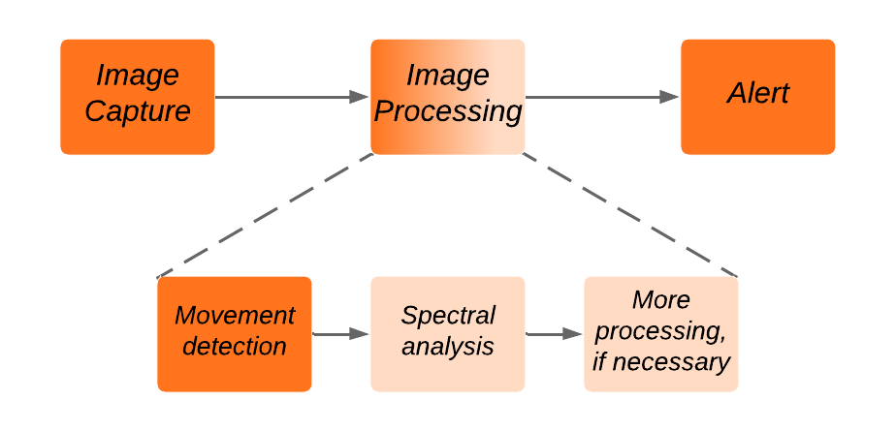
Project Plan
CDR MVP
Final SDNS
ISR MVP
Expected design for ISR is presented clearly
Notes:
Alejandro
Here the plan is to show what we considered when coming up with our design based on the requirements from our sponsors, our skill set as engineers, the environment and user of the system, and how those considerations lead our design and trade studies process
This slide presents the considerations we took prior starting the design and trade studies for our system. This demonstrates our understanding of the goals and limitations of our project and connects with our first objective in slide 3.
Considerations:
Maximize reliability of detection and notification
Maximize cost effectiveness (Budget)
Improve quality of life of patient
Open source
Limitations:
Darkness, bedsheets
Access to training data
Computation power at the edge

Slide 66
CDR Overview
Introduction
Changes Since PDR
PDR Action Items
Requirements Review
System Block Diagrams
System Architecture
System Requirements and SRVM
MVP Definition
Prioritized Requirements
MVP Prototyping Complete
MVP Verification Complete
Analysis and Predictions
Agile Management Process
Configuration Management
Project Plan
Next Design Steps
Expected Design for ISR
Risk Analysis
Cost Analysis
Project Deliverables
Summary

Slide 67
Risk Analysis Initial
 | Risk Criticality
Likelihood | 5
 | 4
 | 3 |  |  |  | 2
 | 2 |  |  | 6 | 1, 4 | 3
 | 1 |  |  |  | 5
 |  | 1 | 2 | 3 | 4 | 5
 | Consequences
Primary Risks:
Accumulating real training data.
Relying on external entities to collect data.
Throughput processing.
Loss of notification system (smartphone).
Transportation of technology.
Mounting of the system.
Our project success is driven by how well we can mitigate the top 2 risks.
Notes:
Juan
Here we want to convey what our biggest risks are, given our resources, knowledge and time. Once identified, we will have generated a set of strategies to minimize such risk so that we can continue carrying on with the project on schedule.
On this side we present our risk analysis in which we have identified the main areas that present risk to our project. We also explain why our MVP is not driven by risk connecting with our second objective in slide 3.

Slide 68
Risk Analysis
Rank | Risk | Risk Description | Risk Response
1 | Accumulating real training data. | If we don't accumulate real data, we run the risk of not producing an accurate detection system. | Designed MVP to collect real training data as primary objective.
2 | Relying on external entities to collect data. | If issues with external entities affect our ability to collect real training data, then we run the risk of not producing an accurate system. | Look for other sources for collection of real training data. Movements can be analyzed for simulation. Proposed alternative is the study of dogs with tonic clonic seizures.
3 | Throughput processing. | If the throughput processing for the Raspberry Pi is inadequate then we run the risk of not processing information per requirements. Changes in computing power could affect cost-effectiveness of project. | Incorporate the use of Intel Neural Compute Sticks for additional image processing. Maximize use of on-board GPU on Raspberry Pi. Additionally, code could be better optimized and a compiler language (C++) could be used over the scripted Python language which compiles directly into machine code for more efficient processing.
Improve risk mitigation plans. They did not like these during PDR. Make sure any current “yellow” or “red” risk has a really good mitigation plan that is within our control
Our project success is driven by how well we can mitigate the top 2 risks.
Notes:
Juan
Here we want to convey what our biggest risks are, given our resources, knowledge and time. Once identified, we will have generated a set of strategies to minimize such risk so that we can continue carrying on with the project on schedule.
On this side we present our risk analysis in which we have identified the main areas that present risk to our project. We also explain why our MVP is not driven by risk connecting with our second objective in slide 3.

Slide 69
Risk Analysis
4 | Loss of notification system (smartphone). | If the Raspberry Pi loses connectivity with the smartphone we run the risk of losing notification functionality on system. | Integrate alert to notify the loss of the connectivity to the Raspberry Pi. Setup local notification on Raspberry Pi 4.
5 | Transportation of technology. | If our system is not transported adequately, we run the risk of damaging/losing our product. | We have enough of a cushion on budget to acquire another system setup. Team member will serve as a courier for the technology.
6 | Mounting of the system. | If room specifications for mounting system cannot be retrieved, the construction of the mounting system is delayed. | Establish different designs that are appropriate for different conditions. This allows for design to be implemented once room specifications are received.
Our project success is driven by how well we can mitigate the top 2 risks.
Notes:
Juan
Here we want to convey what our biggest risks are, given our resources, knowledge and time. Once identified, we will have generated a set of strategies to minimize such risk so that we can continue carrying on with the project on schedule.
On this side we present our risk analysis in which we have identified the main areas that present risk to our project. We also explain why our MVP is not driven by risk connecting with our second objective in slide 3.

Slide 70
Risk Analysis Before & After
 | Risk Criticality
Likelihood | 5
 | 4
 | 3 |  |  |  | 2
 | 2 |  |  | 6 | 1, 4 | 3
 | 1 |  |  |  | 5
 |  | 1 | 2 | 3 | 4 | 5
 | Consequences
 | Risk Criticality
Likelihood | 5
 | 4
 | 3
 | 2 |  |  | 2
 | 1 |  | 4, 5 | 6 | 1, 3
 |  | 1 | 2 | 3 | 4 | 5
 | Consequences
Our project success is driven by how well we can mitigate the top 2 risks.
Notes:
Juan
Here we want to convey what our biggest risks are, given our resources, knowledge and time. Once identified, we will have generated a set of strategies to minimize such risk so that we can continue carrying on with the project on schedule.
On this side we present our risk analysis in which we have identified the main areas that present risk to our project. We also explain why our MVP is not driven by risk connecting with our second objective in slide 3.

Slide 71
CDR Overview
Introduction
Changes Since PDR
PDR Action Items
Requirements Review
System Block Diagrams
System Architecture
System Requirements and SRVM
MVP Definition
Prioritized Requirements
MVP Prototyping Complete
MVP Verification Complete
Analysis and Predictions
Agile Management Process
Configuration Management
Project Plan
Next Design Steps
Expected Design for ISR
Risk Analysis
Cost Analysis
Project Deliverables
Summary

Slide 72
Cost Analysis
INITIAL BUDGET | $ 4,000.00
ITEM | DESCRIPTION | QUANTITY | UNIT PRICE | TOTAL
CanaKit Raspberry Pi 4 4GB Starter Kit - 4GB RAM | Main system for image analysis and processing | 1 | $ 108.59 | $ 108.59
Jira Membership | Main software for project development tracking | 1 | $ 56.00 | $ 56.00
Polo Shirts | Team’s professional attire | 6 | $ 25.00 | $ 150.00
Intel RealSense D415 | Main system for image recording | 1 | $ 165.41 | $ 165.41
MVP TOTAL |  |  |  | $ 480
The project has sufficient resources to complete the work.
Notes:
Here, this slide presents a cost analysis done until now, which explains how much money has been spent so far, and what other expenses we will incur in the next couple months. This supports our thesis statement as it demonstrates we have a clear financial overview of our project, validating our desire to start building the MVP.

Slide 73
Cost Analysis
FUTURE PURCHASES
ITEM | DESCRIPTION | QUANTITY | UNIT PRICE | TOTAL
CanaKit Raspberry Pi 4 4GB Starter Kit - 4GB RAM | Main system for image analysis and processing | 3* | $ 108.59 | $ 325.77
Intel RealSense D415 | Main system for image recording | 3* | $ 165.41 | $ 496.23
Design Day Poster | Show project development and results | 1 | $ 150.00 | $ 150.00
Mounting System | Keep image capture system at desired height | 1 | $ 200.00 | $ 200.00
Training Algorithm | Main way for completion of algorithm | 1** | $ 800.00 | $ 800.00
TOTAL COSTS |  |  |  | $ 1,972.00
The project has sufficient resources to complete the work.
Notes:
Here, this slide presents a cost analysis done until now, which explains how much money has been spent so far, and what other expenses we will incur in the next couple months. This supports our thesis statement as it demonstrates we have a clear financial overview of our project, validating our desire to start building the MVP.

Slide 74
Cost Analysis
Note:
*Additional CanaKit Raspberry Pi 4 4GB Starter Kit - 4GB RAM and Intel RealSense D415 will be purchased for clinical trials.
** Training Algorithm could be removed from budget, due to possibility of using UA High Performance Computers for same purposes.
The project has sufficient resources to complete the work.
Notes:
Here, this slide presents a cost analysis done until now, which explains how much money has been spent so far, and what other expenses we will incur in the next couple months. This supports our thesis statement as it demonstrates we have a clear financial overview of our project, validating our desire to start building the MVP.

Slide 75
CDR Overview
Introduction
Changes Since PDR
PDR Action Items
Requirements Review
System Block Diagrams
System Architecture
System Requirements and SRVM
MVP Definition
Prioritized Requirements
MVP Prototyping Complete
MVP Verification Complete
Analysis and Predictions
Agile Management Process
Configuration Management
Project Plan
Next Design Steps
Expected Design for ISR
Risk Analysis
Cost Analysis
Project Deliverables
Summary

Slide 76
IDL
Doc #: | Title: |  |  |  |  | Revision:
100,000 | System Report |  |  |  |  | A
101,000 | Top Level Assembly Drawing |  |  |  |  | A
 | 101,100 | Image Capture Subsystem |  |  |  | A
 | 101,200 | Image Analysis Subsystem |  |  |  | A
 | 101,300 | Notification Subsystem |  |  |  | ?
102,000 | System Requirement Document |  |  |  |  | A
 | 102,100 | Image Capture System Requirements (Decomposed from 102,000) |  |  |  | A
 | 102,200 | Image Analysis System Requirements (Decomposed from 102,000) |  |  |  | A
 | 102,300 | Notification System Requirements (Decomposed from 102,000) |  |  |  | ?
103,000 | Acceptance Test Procedure |  |  |  |  | A
 | 103,100 | Image Capture Subsystem Verification (From 102,100) |  |  |  | A
 | 103,200 | Image Analysis Subsystem Verification (From 102,200) |  |  |  | A
 | 103,300 | Notification Subsystem Verification (From 102,300) |  |  |  | ?
104,000 | System Requirement Data Sheet (From 103,000) |  |  |  |  | A
 | 104,100 | Image Capture Requirement Data Sheets |  |  |  | A
 | 104,200 | Image Analysis Requirement Data Sheets |  |  |  | A
 | 104,300 | Notification Requirement Data Sheets |  |  |  | ?
The IDL organizes system components and documents for release

Slide 77
IDL
Doc #: | Title: |  |  |  |  | Revision:
105,000 | System Models |  |  |  |  | A
 | 105,100 | Throughput Analysis |  |  |  | A
 | 105,200 | Motion Detection Model |  |  |  | A
 | 105,300 | Seizure Detection Model |  |  |  | A
106,000 | System Software Description Document |  |  |  |  | A
 | 106,100 | Image Capture Software |  |  |  | A
 | 106,200 | Motion Detection Software |  |  |  | A
 | 106,300 | Seizure Detection Software |  |  |  | ?
 | 106,400 | Notification Sending Software |  |  |  | ?
 | 106,500 | Notification App Software |  |  |  | ?
107,000 | System Interface Control Document |  |  |  |  | A
108,000 | Engineering Change Requests
109,000 | System Reviews
 | 109,100 | ConOps |  |  |  | A
 | 109,200 | Proposal |  |  |  | A
 | 109,300 | PDR |  |  |  | A
 | 109,400 | CDR |  |  |  | A
 | 109,500 | ISR
 | 109,600 | FAR
The IDL organizes system components and documents for release

Slide 78
Project Deliverables
Initial Date: | Title | Details | Status | Release on 1/25/19:
September 12, 2019 | Proposal 109,200 | Initial proposal for system | ✔️ | A
October 1, 2019 | SRD 102,000 | Established the system requirements and verification | ✔️ | A
October 29, 2019 | PDR 109,300 | Preliminary view of CDR | ✔️ | A
December 3, 2019 | CDR 109,400 | (Ready MVP ➝ Clinical Trials) | ✔️ | A
January 25, 2020 | CDR Report 100,000 | MVP Document (SBD, SDD, SRVM, SRD, TPs) |  | A
March 3, 2020 | ISR 109,500 | Changes since CDR, Part status, TDP, Budget New revision of system report and its content |  | N/A
April 23, 2019 | FAR 109,600 | Changes since ISR, FAT, Budget, Deliverables |  | N/A
May 4, 2020 | Design Day | Present the system final status and its results |  | N/A
Notes:
Here, the objective is to present a minimum number of deliveries in which oir system will be augmented each time, with more and more system requirements being verified at each stage until we reach design day and deliver the final system
This slide serves the purpose of visually portraying the different milestones proposed for this project as well as the deliverables that will be shown in each review date.

Slide 79
CDR Overview
Introduction
Changes Since PDR
PDR Action Items
Requirements Review
System Block Diagrams
System Architecture
System Requirements and SRVM
MVP Definition
Prioritized Requirements
MVP Prototyping Complete
MVP Verification Complete
Analysis and Predictions
Agile Management Process
Configuration Management
Project Plan
Next Design Steps
Expected Design for ISR
Risk Analysis
Cost Analysis
Project Deliverables
Summary

Slide 80
Summary
MVP as-built configuration understood and captured
MVP has been verified to a controlled process
Steps to complete as-defined MVP understood and plans are made to overcome the obstacles
Impact of MVP on the overall project is understood
Next steps are understood:
Which requirements are verified
Requirements have been decomposed for next delivery configuration
Expected design for ISR understood and presented
We have built and verified our CDR MVP SDNS,
and we are ready to build and verify our ISR MVP SDNS.
Notes:
Here we summarize all the information presented focusing on our understanding of the requirements of the system, risk, and how we used such categories to choose an MVP and show that we are ready to build it.

Slide 81
Epileptic Seizure Detection and Notification System
Critical Design Review
Thank You

Slide 82
Backup slides

Slide 84
System Architecture and Requirements Prioritization
The Agile process places emphasis on delivering value to the customer as soon as possible in the form of a MVP.
System requirements relevant to the MVP were identified and decomposed into subsystem requirements.
Those were then further prioritized by what would be delivered by CDR for the MVP.
MVP was defined using a portion of our system requirements.

Slide 85
System Architecture and Requirements Prioritization
System Requirement | Subsystem Requirement | Verification | Subsystem
SR1.1: The system shall capture images at a rate above 16 FPS. | 1.1.1: The system shall capture RGB images at a resolution of at least 1280x720 pixels | I | Image Capture
 | 1.1.2: The system shall capture RGB images at a rate of at least 16 FPS. | I | Image Capture
 | 1.1.3: The system shall create a depth map at a resolution of at least 640x480 and at a rate of at least 16 FPS. | I | Image Capture
Yellow = Part of MVP | 1.1.4: The system shall be able to save the images and depth maps captured. | I | Image Capture
Notes:
Louie
Here we explain which system requirements need attention from the beginning given that they present higher risk than others, thus should be tackled as soon as possible.
List the system requirements that were decomposed, the sub-system requirements with their verification type (A/T/I/D)
In this slide, we present our prioritization of system requirements, the decomposition of selected system requirements based off risk and critical technology, so that our MVP can provide value to our customer and can drive us to the finished system as a starting point.

Slide 86
System Architecture and Requirements Prioritization
System Requirement | Subsystem Requirement | Verification | Subsystem
SR1.2: The system shall perform steady-state processing at rate above 16 FPS. | 1.2.1: The system shall perform the motion detection algorithm at rate of at least 16 FPS. | T | Image Analysis
 | 1.2.2: The system shall perform the seizure detection algorithm at rate of at least 16 FPS. | T | Image Analysis
Yellow = Part of MVP | 1.2.3: The system shall use a Raspberry Pi and optional Neural Compute Sticks to analyze data from the Image Capture subsystem to detect a seizure. | T | Image Analysis
The MVP will focus on detecting motion
in a video and using that as training data.
Notes:
Louie
Here we explain which system requirements need attention from the beginning given that they present higher risk than others, thus should be tackled as soon as possible.
List the system requirements that were decomposed, the sub-system requirements with their verification type (A/T/I/D)
In this slide, we present our prioritization of system requirements, the decomposition of selected system requirements based off risk and critical technology, so that our MVP can provide value to our customer and can drive us to the finished system as a starting point.

Slide 87
System Architecture and Requirements Prioritization
System Requirement | Subsystem Requirement | Verification | Subsystem
SR1.3: The system shall detect a seizure with at least 90 percent accuracy. | 1.3.1: The system shall detect motion on data from the Image Capture subsystem. | T | Image Analysis
 | 1.3.2: The system shall detect motion through a bedsheet. | T | Image Analysis
Yellow = Part of MVP | 1.3.3: The system shall detect a seizure on data from the Image Capture subsystem. | T | Image Analysis
The MVP will focus on detecting motion
in a video and using that as training data.
Notes:
Louie
Here we explain which system requirements need attention from the beginning given that they present higher risk than others, thus should be tackled as soon as possible.
List the system requirements that were decomposed, the sub-system requirements with their verification type (A/T/I/D)
In this slide, we present our prioritization of system requirements, the decomposition of selected system requirements based off risk and critical technology, so that our MVP can provide value to our customer and can drive us to the finished system as a starting point.

Slide 88
System Architecture and Requirements Prioritization
System Requirement | Subsystem Requirement | Verification | Subsystem
SR1.4: The system shall operate independently from the presence of visible light, in room-ambient conditions. | 1.4.1: The Image Capture subsystem shall be able to gather relevant data in low light conditions. | T | Image Capture
 | 1.4.2: The Image Capture subsystem shall operate in room-ambient conditions | I | Image Capture
Yellow = Part of MVP | 1.4.3: The Image Analysis subsystem shall operate in room-ambient conditions | I | Image Analysis
The MVP will be able to operate in the same conditions
as the final product.
Notes:
Louie note that no notification sunsystem tasks will be targeted, but it will be worked in parallel
Here we explain which system requirements need attention from the beginning given that they present higher risk than others, thus should be tackled as soon as possible.
List the system requirements that were decomposed, the sub-system requirements with their verification type (A/T/I/D)
In this slide, we present our prioritization of system requirements, the decomposition of selected system requirements based off risk and critical technology, so that our MVP can provide value to our customer and can drive us to the finished system as a starting point.

Slide 89
MVP Definition
MVP was defined based on the risk of gathering as much real clinical data
These system define what the minimum viable product shall be because it will allow us to use a depth camera (1.1) to gather and process training data (1.2, 1.3) while operating under dark or illuminated conditions at room-ambient conditions (1.4)
(Yellow = Fully applies to MVP)
1.1 | The system shall capture images at a rate above 16 fps.
1.2 | The system shall perform steady-state processing at rate above 16 fps.
1.3 | The system shall detect a seizure with at least 90 percent accuracy
1.4 | The system shall operate independently from the presence of visible light, in room-ambient conditions.
Notes:
Alejandro
Here the plan is to give a detailed description of our MVP so that our sponsor and mentors can observe how we have chosen this first deliverable based on our risk analysis, trade studies and requirements prioritization. The audience will be able to see how this MVP encompasses the most critical areas of our project and how such areas will start to be tackled early on.

Slide 90
Models & Analyses
IR Stereo Camera can capture a depth map at a rate up to 90 fps with a resolution up to 1280x720.
The depth can be analyzed in a sliding time window of 10 seconds where the RMS can be calculated as the window slides every second.
In the same time window, a Fourier Analysis can be done to analyze data in a spectral domain.
This protects the privacy of the patient, as the depth map and the frequency data does not contain any private recognizable information about the patient.
Frequency analysis is a method that protects the patient and increases our chances of obtaining high detection accuracy.
Notes:
Alejandro
-Stretch goal of alarm to notify medication need.

Slide 91
Models & Analyses
Final SDNS
Overall operation of the final system is based on three main stages.
Notes:
Gordon
-Stretch goal of alarm to notify medication need.

Slide 92
Models & Analyses
MVP SDNS
Our MVP will perform critical parts of the final image processing algorithm.
Notes:
Gordon
-Stretch goal of alarm to notify medication need.

Slide 93
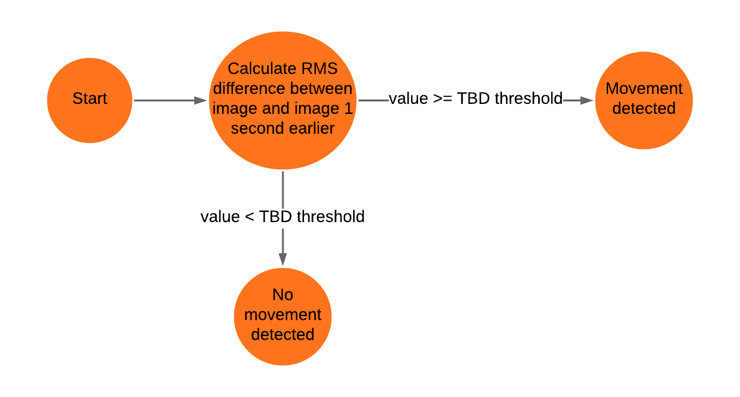
Models & Analyses
PDR movement detection algorithm
It was pointed out during PDR that our movement detection algorithm was likely not robust enough.
Notes:
Gordon
-Stretch goal of alarm to notify medication need.

Slide 94
Test Plan for MVP
MVP verification will start at the component level.
Subsystem verification is done by making sure subsystem requirements for the MVP are satisfied.
Subsystems will be integrated for final MVP verification.
Component Verification
Subsystem Verification
Integration Verification
MVP verification starts at the component level
and works to integration.
Notes:
Louie
Based on our MVP Definition, here we will explain how it should be verified so that by December, our MVP will have satisfied some of the system requirements of our project so that after that, we can focus on developing the remaining requirements and add functionality to the system based off that.
Presenting our tests plan for the MVP is a crucial part of the presentation as it explains to the customer and mentors how our proposed MVP is not only build able but also verifiable in terms of the system requirements that encompass such MVP. This connects with our third objective in slide 3 about demonstrating verification methods for our MVP to show we are ready to build and verify it.

Slide 95
Test Plan for MVP
The verification will start with SR1.4: The system shall operate in dark, room-ambient conditions.
Camera and computer trade studies factored in the need to fulfill this requirements.
Subsystem Requirement | Verification
1.4.1: The Image Capture subsystem shall be able to capture images in low light conditions. | T
1.4.2: The Image Capture subsystem shall operate in room-ambient conditions | I
1.4.3: The Image Analysis subsystem shall operate in room-ambient conditions | I
Notes:
Louie
Based on our MVP Definition, here we will explain how it should be verified so that by December, our MVP will have satisfied some of the system requirements of our project so that after that, we can focus on developing the remaining requirements and add functionality to the system based off that.
Presenting our tests plan for the MVP is a crucial part of the presentation as it explains to the customer and mentors how our proposed MVP is not only build able but also verifiable in terms of the system requirements that encompass such MVP. This connects with our third objective in slide 3 about demonstrating verification methods for our MVP to show we are ready to build and verify it.

Slide 96
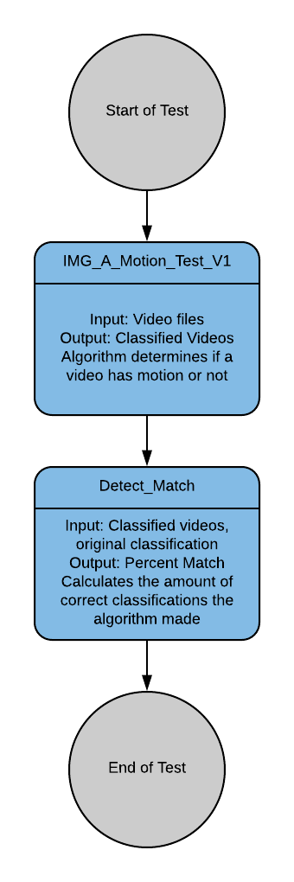
Test Plan for MVP
Requirement 1.3.1: The system detect motion on data from the Image Capture subsystem.
Environment: The software test will be performed on a Raspberry Pi 4 using Ubuntu Desktop 18.04 where only the Image Capture subsystem, Image Analysis subsystem and testing software will be active.
Input: IMG_A_Motion_Test_V1 shall feed pre-classified video and data of someone moving into the Image Analysis subsystem.
Outcome: The algorithm subsystem will classify the data it is given as “Movement” or “No Movement”. The results will be compared to the original classifications. The test passes if 90 % match is achieved.

Slide 97
Test Plan for MVP
Integration Verification
Once MVP system and subsystem requirements have been verified individually the MVP will be tested as a complete system.
The verification will involve having the system fully set-up and movement under a sheet will be done to test for detection.
The MVP will also be tested for the ability to send video to a cloud server.
Testing procedure will be refined and expanded
throughout the creation of CDR.

Slide 98
Epileptic Seizure Detection and Notification System
Preliminary Design Review
Thank You

Slide 99
Backup slides

Slide 100
Test Plan for MVP
SR1.1 and its subsystem requirements verification occur at the component level as well.
Subsystem Requirement | Verification
1.1.1: The system shall capture RGB images at a resolution of at least 1280x720 pixels | I
1.1.2: The system shall capture RGB images at a rate of at least 16 FPS. | I
1.1.3: The system shall create a depth map at a resolution of at least 640x480 and at a rate of at least 16 FPS. | I
1.1.4: The system shall be able to save the images and depth maps captured. | I

Slide 101
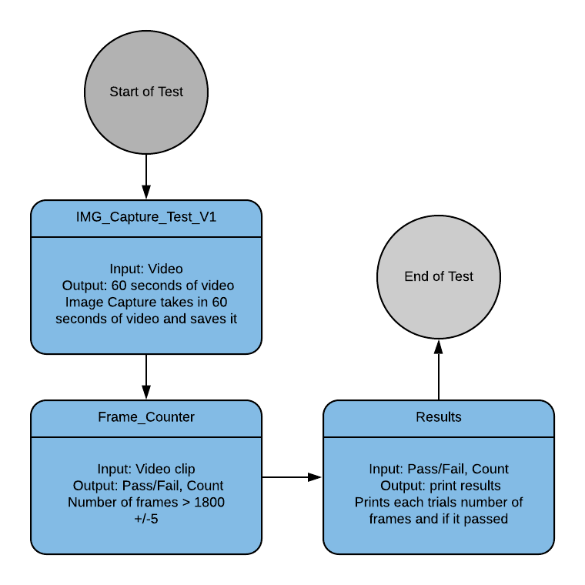
Test Plan for MVP
Requirement SR1.1.2: The system shall capture images at a rate of at least 16 FPS.
Environment: The software test will be performed on a Raspberry Pi 4 using Ubuntu Desktop 18.04 where only the Image Capture subsystem and testing software will be active.
Input: IMG_Capture_Test_V1 shall be run on the Raspberry Pi 4 10 times. The test shall capture 60 seconds of video on each run.
Outcome: The test will yield 10 60-second video clips. The number of frames captured in each clip will be counted using a Python script. The Requirement SR1.1.2 will be verified if all the clips have at least (16 frames) * (60 seconds) +/- 2 frames.

Slide 102
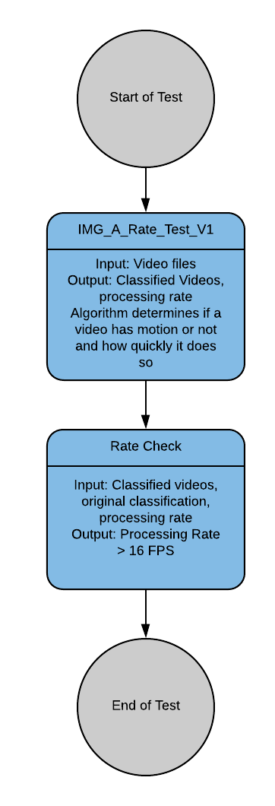
Test Plan for MVP
Requirement 1.2.1: The system shall perform the motion detection algorithm at rate of at least 16 FPS.
Environment: The software test will be performed on a Raspberry Pi 4 using Ubuntu Desktop 18.04 where only the Image Capture subsystem, Image Analysis subsystem and testing software will be active.
Input: IMG_A_Rate_Test_V1 shall feed pre-classified video and data of someone moving into the Image Analysis subsystem.
Outcome: The algorithm subsystem will classify the data it is given as “Movement” or “No Movement” and the rate of which frames are processed will be monitored. The results will be compared to the original classifications. The test passes if the algorithm detects motion at a rate greater than 16 frames per second.

Slide 103
Test Plan for MVP
By December system will be able to take in data in the form of video and depth maps, and an algorithm will be able to analyze that data.
Hooks in the system will allow us to upload data from the MVP to the cloud for further analysis.
MVP will be ready to start collecting data
Notes:
Louie
Based on our MVP Definition, here we will explain how it should be verified so that by December, our MVP will have satisfied some of the system requirements of our project so that after that, we can focus on developing the remaining requirements and add functionality to the system based off that.
Presenting our tests plan for the MVP is a crucial part of the presentation as it explains to the customer and mentors how our proposed MVP is not only build able but also verifiable in terms of the system requirements that encompass such MVP. This connects with our third objective in slide 3 about demonstrating verification methods for our MVP to show we are ready to build and verify it.

Slide 104
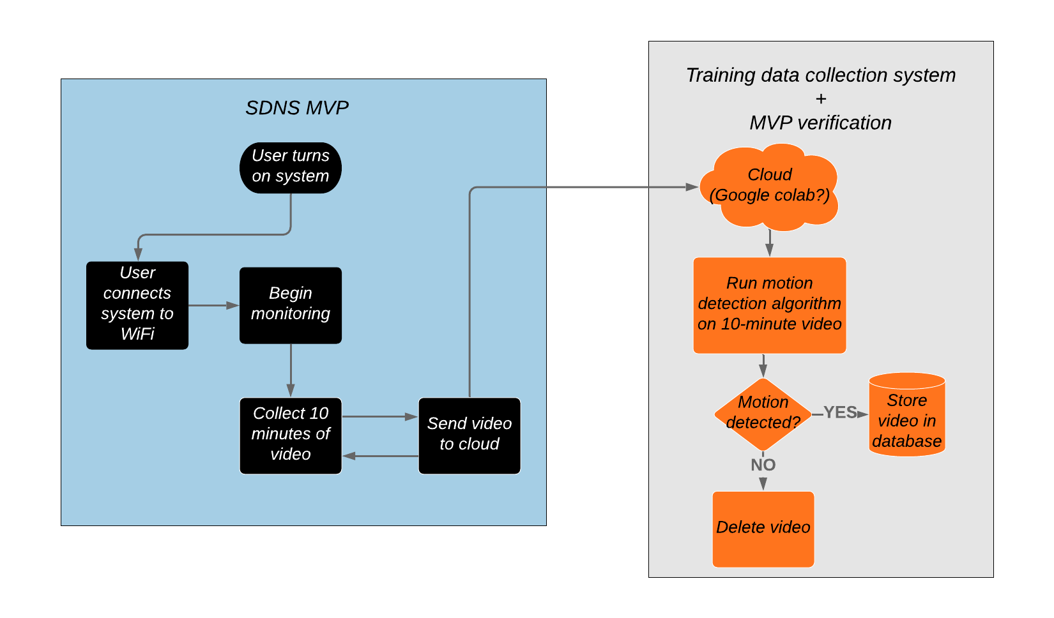
MVP software configuration with motion detection algorithm on cloud
An alternative model for MVP verification is ready to be implemented
Notes:
Alejandro and Gordon
-Stretch goal of alarm to notify medication need.

Slide 105
Camera Trade Study
Active IR Stereo Camera Best Choice (1=Worst Choice 10=Best Choice)
Trade Factors | Weight | Intel RealSense R200 |  | Intel RealSense D415 |  | eYs3D eSP870
 |  | Score | Factor Total | Score | Factor Total | Score | Factor Total
Performance Best-Choice | 9 | 6.4 | 57.6 | 8.4 | 75.6 | 5.8 | 52.2
Accuracy | 9 | 6 | 54 | 9 | 81 | 4 | 36
FOV | 6 | 6 | 36 | 8 | 48 | 7 | 42
Depth resolution | 8 | 5 | 40 | 9 | 72 | 6 | 48
Connectivity | 7 | 8 | 56 | 8 | 56 | 8 | 56
FPS | 6 | 7 | 42 | 8 | 48 | 4 | 24
Schedule Best-Choice | 5 | 9 | 45 | 8 | 40 | 6 | 30
Cost Best-Choice | 6 | 8 | 48 | 7 | 42 | 6 | 36
Total Score |  | 150.6 |  | 157.6 |  | 118.2
 | RealSense R200 | RealSense D415 | eYs3D eSP870
Accuracy | More than 3cm error at 2m | <= 2%, which is 3cm at 1.5m distance | <= 7.43 cm at 1.5m
FOV | H 59 +/- 5° V 46 +/- 5° D 70 +/- 4.5° | H 69.4° V42.5° D77° | H 63.2° V 42°
Depth resolution | 628x468 | 1280x720 | 640x480
Connectivity | USB 3.0 | USB 3.0 Type-C | USB 3.0
Depth FPS | 60 | 90 | 30
Lead time | Already have it | 3 days | 3-11 days
Cost | $75.00 | $144 | $179
Production status | Discontinued | Current | Current
Notes:
Active IR Camera trade Study was done with the information found in the datasheets found online on the manufacturers' websites. Information was summarized in the table below
R200
https://www.intel.com/content/dam/support/us/en/documents/emerging-technologies/intel-realsense-technology/realsense-camera-r200-datasheet.pdf
D415
https://www.mouser.com/pdfdocs/Intel_D400_Series_Datasheet.pdf
eYe3D
https://cdn.sparkfun.com/assets/6/5/9/1/8/eAP87003C_EX8029_Datasheet_Non-NDA-Rev1.0.pdf

Slide 106
Image Analysis Algorithm Trade Study
Image Analysis Algorithm Best Choice (1=Worst Choice 10=Best Choice)
Trade Factors | Weight | Neural network directly on camera output |  | Out-of-the-box pose estimation followed by NN seizure classif. |  | Frequency analysis with gradient descent of a few parameters
 |  | Score | Factor Total | Score | Factor Total | Score | Factor Total
Performance Best-Choice | 10 | 5.2 | 51.7 | 7.2 | 71.7 | 7.3 | 73.3
Amount of training data required | 9 | 3 | 27 | 5 | 45 | 10 | 90
Difficulty of obtaining relevant training data | 7 | 5 | 35 | 4 | 28 | 9 | 63
Computational load for training | 5 | 3 | 15 | 6 | 30 | 9 | 45
Ease of expanding capabilities | 6 | 8 | 48 | 10 | 60 | 3 | 18
Generalizability in other settings | 6 | 3 | 18 | 10 | 60 | 8 | 48
Ability to interface with hardware | 5 | 9 | 45 | 8 | 40 | 5 | 25
Schedule Best-Choice | 8 | 4 | 32 | 4 | 32 | 8 | 64
Cost Best-Choice | 6 | 3 | 18 | 5 | 30 | 9 | 54
Total Score |  | 101.7 |  | 133.7 |  | 191.3
 | NN on camera | Pose est -> NN | Freq analysis
Amount of training data required | Order of 100,000 samples | Order of 10,000 samples | Order of 100 samples
Difficulty of obtaining relevant training data | Need RGB videos of seizures | Need depth map videos of seizures | May be able to use many sources of training data (find char. freq.)
Computational load for training | Large amount of training req | Moderate amount of training req | Small amount of training req
Ease of expanding capabilities | Easy to add hooks for more inputs + outputs | Easy to add hooks to 2nd NN for more inputs + outputs | Hooks and new features non-trivial to implement
Generalizability in other settings | NN very specific to angle, setting | NN independent of angle, setting | indep. of angle & setting, but observed freqs may change
Ability to interface with hardware | One NN with neural compute sticks | Two NNs with neural compute sticks | Tricky to interface with NCSs
Schedule | Hard to get training data, easy NN | Easier to get train data, harder NN | Easy to implement algorithm
Cost | Large amount of cloud training req | Moderate amount of cloud training | Small amount of cloud training
Notes:
Active IR Camera trade Study was done with the information found in the datasheets found online on the manufacturers' websites. Information was summarized in the table below
R200
https://www.intel.com/content/dam/support/us/en/documents/emerging-technologies/intel-realsense-technology/realsense-camera-r200-datasheet.pdf
D415
https://www.mouser.com/pdfdocs/Intel_D400_Series_Datasheet.pdf
eYe3D
https://cdn.sparkfun.com/assets/6/5/9/1/8/eAP87003C_EX8029_Datasheet_Non-NDA-Rev1.0.pdf

Slide 107
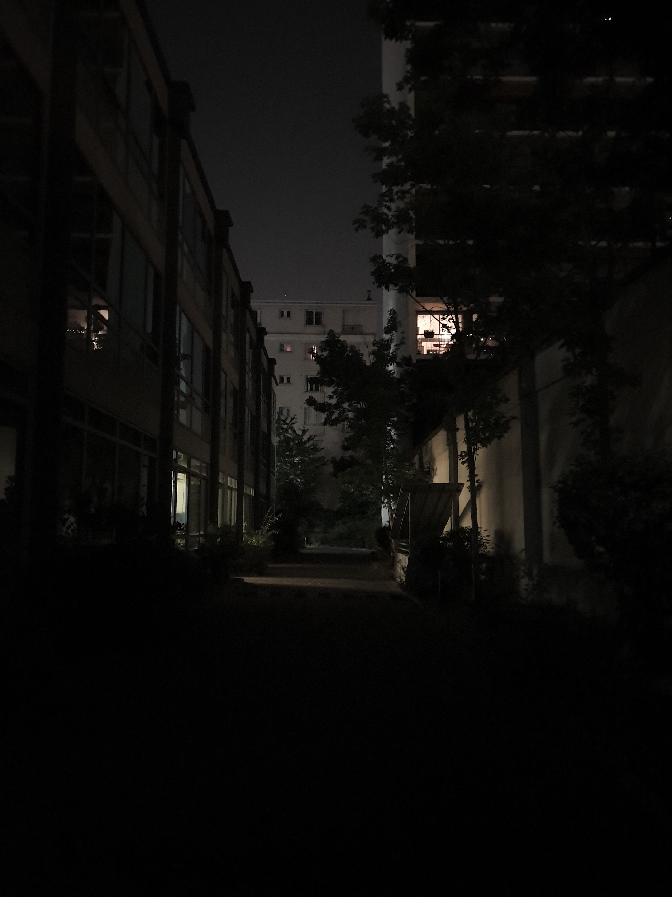

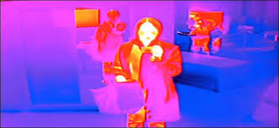
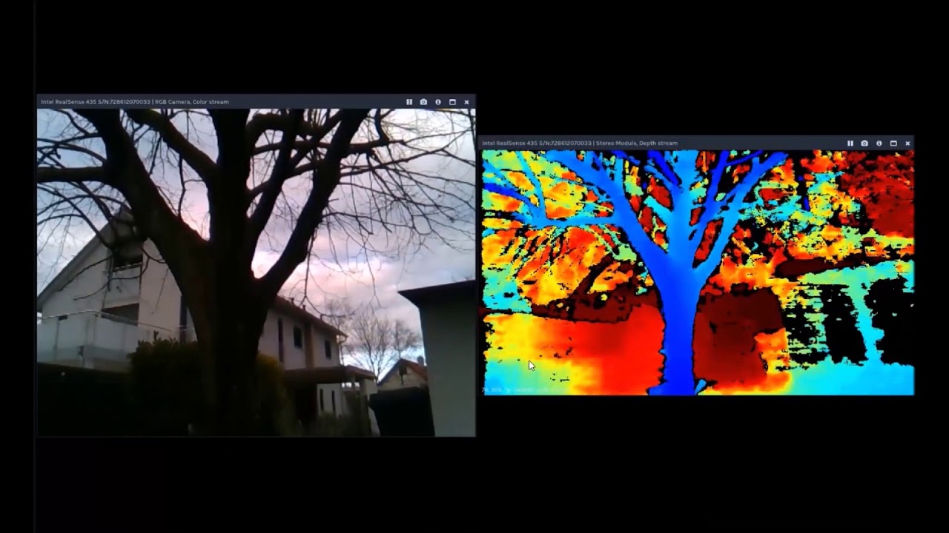
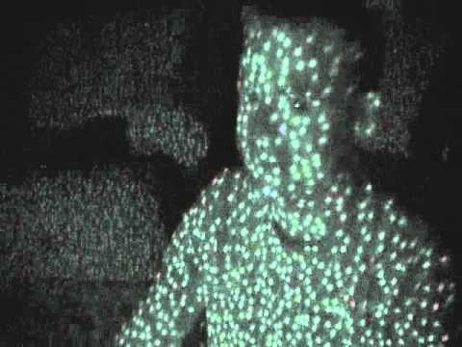
Type of Camera Trade Study
Low Light Use: (left to right: RGB, Near-IR, Thermal, Active IR Stereo

Slide 108
Type of Camera Trade Study
Sensitivity:
RGB: Resolutions up to 4K, 1080p resolution achievable in cheap sensors
Near-IR: typically up to 640x512 https://lot-qd.de/en/products/imaging/near-infrared-and-shortwave-infrared-cameras/
Thermal camera: For inexpensive sensor (below $500) 0.25 °C but with very low resolution (64 pixels total). https://cdn-learn.adafruit.com/assets/assets/000/043/261/original/Grid-EYE_SPECIFICATIONS%28Reference%29.pdf?1498680225
Active IR Stereo: Depth map with a resolution up to 1280x720 pixels, 10 bit. (Realsense D415)

Slide 109
Trade Studies
Computer Trade Study
Computer Best Choice
Trade Factors | Weight | Intel NUC Kit NUC7i7BNH |  | Raspberry Pi 4 Model B |  | Udoo x86 Ultra
 |  | Score | Factor Total | Score | Factor Total | Score | Factor Total
Performance Best-choice | 9 | 7.4 | 66.6 | 5.2 | 46.8 | 6.4 | 57.6
RAM | 9 | 9 | 81 | 5 | 45 | 7 | 63
CPU | 8 | 8 | 64 | 5 | 40 | 7 | 56
Connectivity | 7 | 6 | 42 | 5 | 35 | 7 | 49
Ports | 3 | 7 | 21 | 6 | 18 | 4 | 12
Operating system | 5 | 7 | 35 | 5 | 25 | 7 | 35
Schedule Best-choice | 4 | 6 | 24 | 6 | 24 | 6 | 24
Cost Best-choice | 6 | 4 | 24 | 8 | 48 | 6 | 36
Total Score |  | 114.6 |  | 118.8 |  | 117.6

Slide 110
Notification App Trade Study
Design Considerations:
Able to be developed, tested, and used by the whole team
Lowest barrier to entry possible for programing
Can support key function of communicating with a Raspberry Pi
Low risk aspect to project
Design Concept:
Create app that receive data from Raspberry Pi
Use a flexible, adaptable system
Must be able to access alarm system on platform
Testable
iOS
Android
NativeScript
Contract Out
Existing App

Slide 111
Trade Studies
Notification App Trade Study
Type of Notification App Development
Trade Factors | Weight | iOS |  | Android |  | Both(NativeScript or Other) |  | Contract Out
 |  | Score | Factor Total | Score | Factor Total | Score | Factor Total | Score | Factor Total
Performance Risks | 8 | 5.14 | 41.14 | 6.14 | 49.14 | 6.71 | 53.71 | 7.14 | 57.14
Ease of Dev | 8 | 3 | 24 | 7 | 56 | 8 | 64 | 10 | 80
Communication | 9 | 5 | 45 | 7 | 63 | 8 | 72 | 4 | 36
Adaptability | 5 | 4 | 20 | 5 | 25 | 6 | 30 | 2 | 10
Reliability | 10 | 8 | 80 | 5 | 50 | 7 | 70 | 8 | 80
UI/UX | 3 | 8 | 24 | 6 | 18 | 7 | 21 | 8 | 24
Language | 6 | 3 | 18 | 8 | 48 | 8 | 48 | 9 | 54
Testing | 7 | 5 | 35 | 5 | 35 | 3 | 21 | 9 | 63
Schedule Risk | 5 | 7 | 35 | 8 | 40 | 8 | 40 | 4 | 20
Cost Risk | 2 | 5 | 10 | 8 | 16 | 8 | 16 | 1 | 2
Total Score |  | 86.14 |  | 105.14 |  | 109.71 |  | 79.14

Slide 112
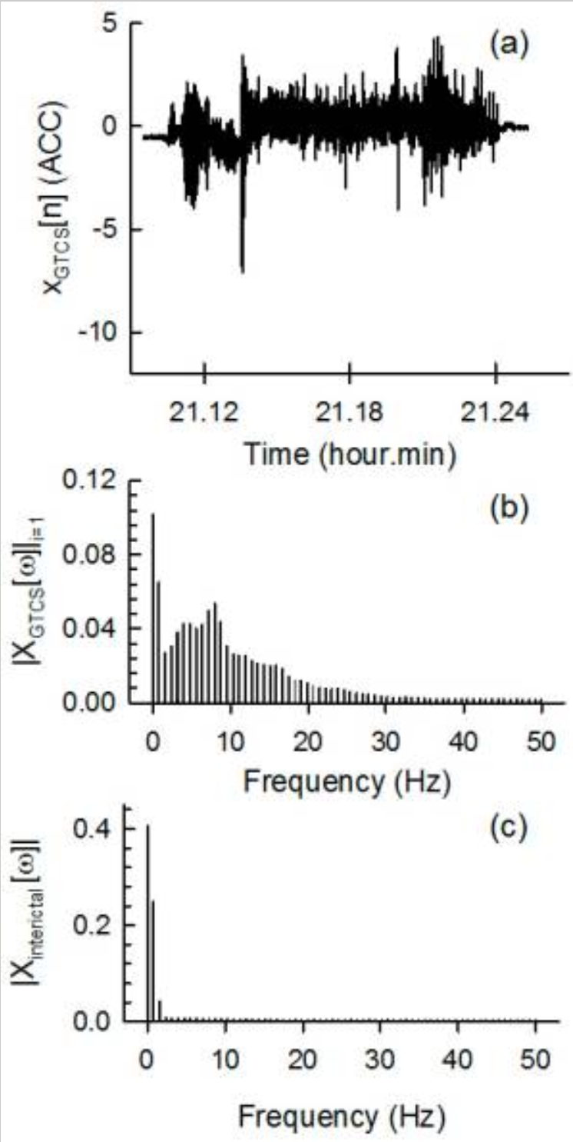
Spectral Approach
Paper from 2017 by Joo, Han, Lee, Yang, Kang & Woo.
Describe the use of gyroscopes and analyzing data in a spectral domain.
Very characteristic frequency regions were found for Tonic-Clonic Seizures when compared to the interictal (between seizures) data.
https://www.ncbi.nlm.nih.gov/pmc/articles/PMC5375767/

Slide 113
Bitrates for sending data to cloud
According to our sponsors at Intel (subject matter experts), our RealSense color video (720p at 30 fps) can be compressed at ~1 Mbps using HEVC (High Efficiency Video Coding).
1 Mbps = ⅛ MBps = 7.5 MB/min
Color video:depth video is 3:1 in bits per pixel, so:
Total for both video streams is 10 MB/min
An alternative model for MVP verification is ready to be implemented
Notes:
Alejandro and Gordon
-Stretch goal of alarm to notify medication need.

Slide 114
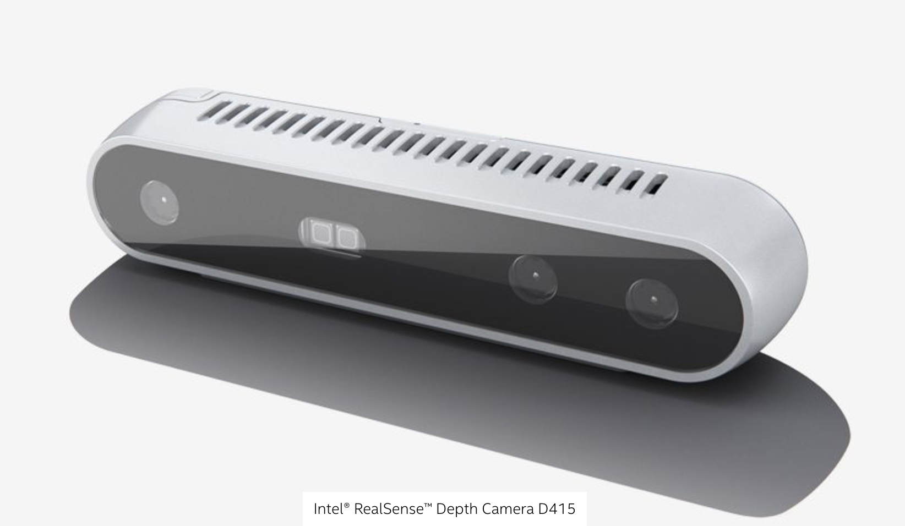
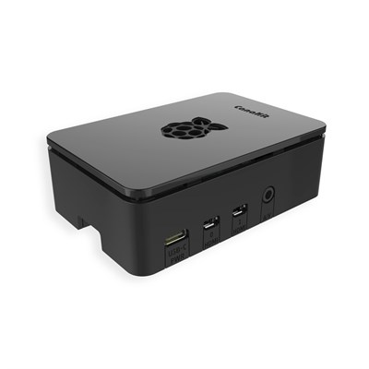
Final Concept
Point Design developed from trade studies.
Notes:
Humberto
Here, our goal is to present an idea of what our system will look like and how it will operate when its fully functional. This is what we intend to present on Design Day and it is our final deliverable
Here we present the final concept which is an outcome of the trade studies and concludes our first objective as we fully demonstrate understanding of how the final system shall operate to satisfy the given system requirements.

Slide 115
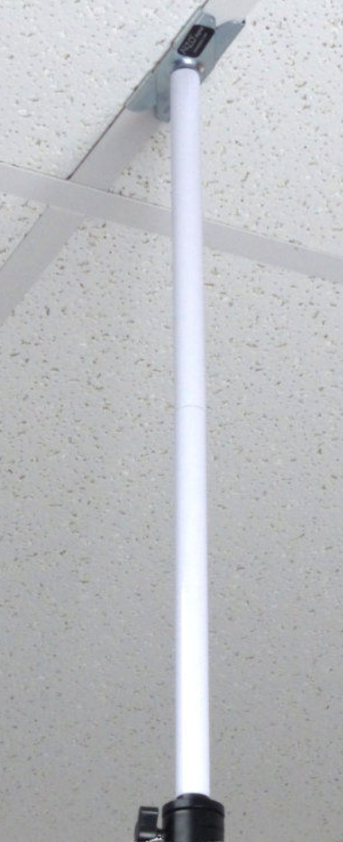
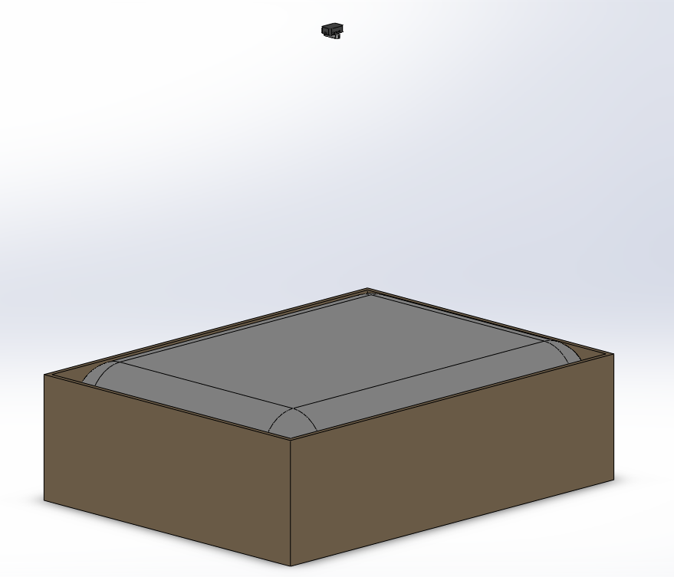
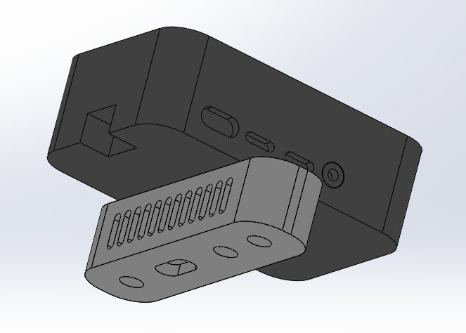
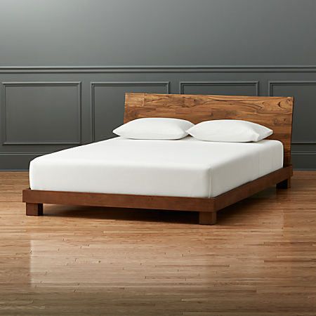
Final Concept
Point Design developed from trade studies.
Notes:
Humberto
Here, our goal is to present an idea of what our system will look like and how it will operate when its fully functional. This is what we intend to present on Design Day and it is our final deliverable
Here we present the final concept which is an outcome of the trade studies and concludes our first objective as we fully demonstrate understanding of how the final system shall operate to satisfy the given system requirements.

Slide 116
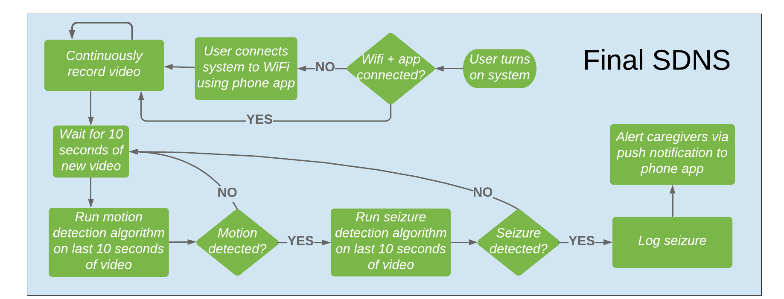
Final Concept: Software
Point Design developed from trade studies and discussions with sponsors.
Notes:
Gordon
Here, our goal is to present an idea of what our system will look like and how it will operate when its fully functional. This is what we intend to present on Design Day and it is our final deliverable
Here we present the final concept which is an outcome of the trade studies and concludes our first objective as we fully demonstrate understanding of how the final system shall operate to satisfy the given system requirements.

Slide 117
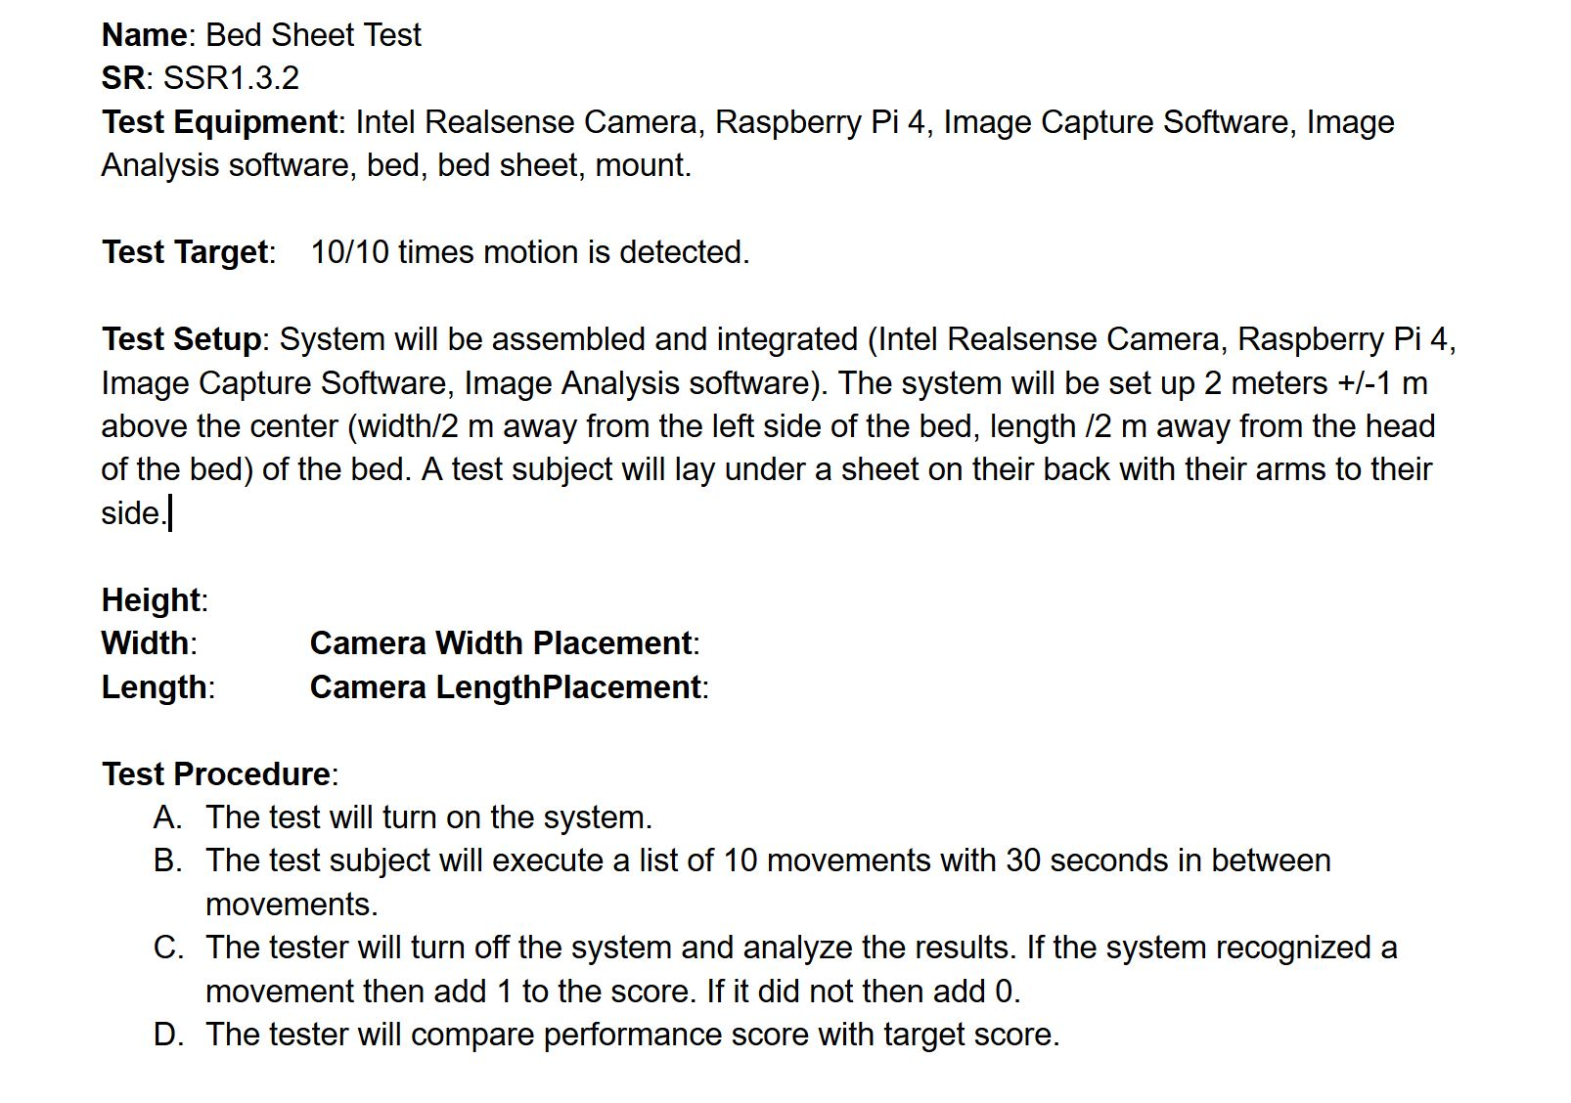
Sample Verification Procedure

Slide 118
Img_Cap_T1
Name: RBG Rate Test
ID: Img_Cap_T1
SR: SSR1.1.2
Test Equipment: Intel Realsense Camera, Raspberry Pi 4, Image Capture Software.
Test Target: >=16 FPS Recorded
>=60seconds*16FPS=960 frames
Test Setup: The Raspberry Pi will be loaded with the Image Capture Software. The Camera will be plugged in to the Pi, and set up 2 m +/-.1m from an object. The test is ready to begin.
Test Procedure:
The tester will use the Raspberry Pi to start recording video.
The tester will wait 60 seconds and stop the recording.
The system will output the number of Frames Collected total for RGB video.
The tester will calculate FPS = (Frames Collected / Seconds).
The tester will record data and end test.
Measurement: _____ FPS

Slide 119
Img_Cap_T2
Name: Depth Map Rate Test
ID: Img_Cap_T2
SR: SSR1.1.4
Test Equipment: Intel Realsense Camera, Raspberry Pi 4, Image Capture Software.
Test Target: >=16 FPS Recorded
>=60seconds*16FPS=960 frames
Test Setup: The Raspberry Pi will be loaded with the Image Capture Software. The Camera will be plugged in to the Pi, and set up 2 m +/-.1m from an object. The test is ready to begin.
Test Procedure:
The tester will use the Raspberry Pi to start recording video.
The tester will wait 60 seconds and stop the recording.
The system will output the number of Frames Collected total for the Depth Map.
The tester will calculate FPS = (Frames Collected / Seconds).
The tester will record data and end test.
Measurement: _____ FPS

Slide 120
Img_Ana_T1
Name: Bed Sheet Test
ID: Img_Ana_T3
SR: SSR1.3.2
Test Equipment: Intel Realsense Camera, Raspberry Pi 4, Image Capture Software, Image Analysis software, bed, bed sheet, mount.
Test Target: 10/10 times motion is detected.
Test Setup: System will be assembled and integrated (Intel Realsense Camera, Raspberry Pi 4, Image Capture Software, Image Analysis software). The system will be set up 2 meters +/-1 m above the center (width/2 m away from the left side of the bed, length /2 m away from the head of the bed) of the bed. A test subject will lay under a sheet on their back with their arms to their side.
Height:
Width: Camera Width Placement:
Length: Camera Length Placement:
Test Procedure:
The test will turn on the system.
The test subject will execute a list of 10 movements with 30 seconds in between movements, return to the starting position after each movement.
The tester will turn off the system and analyze the results. If the system recognized a movement then add 1 to the score. If it did not then add 0.
The tester will compare performance score with target score.
Measurement: ___/10 Correct

Slide 121
Img_Ana_T2
Name: Movement Integration Test
ID: Img_Ana_T2
SR: SSR1.3.1
Test Equipment: Intel Realsense Camera, Raspberry Pi 4, Image Capture Software, image analysis software
Test Target: 10/10 Movement Detected
Test Setup: System will be assembled and integrated (Intel Realsense Camera, Raspberry Pi 4, Image Capture Software, Image Analysis software). The system will be set up 2 meters +/-.1 m above the center (width/2 +/-.1 m away from the left side of the bed, length /2 +/-.1 m away from the head of the bed) of the bed. A test subject will lay on their back with their arms to their side.
Height:
Bed Width: Camera Width Placement:
Bed Length: Camera LengthPlacement:
Test Procedure:
The test will turn on the system.
The test subject will execute a list of 10 movements for 10 seconds each with 30 seconds in between movements, returning to the starting position after each movement.
After each movement is completed, the tester will mark if the system detected the motion (1=true, 0=false).
After 10 movements, scores will be compiled.
Measurement: ___/10 Movements

Slide 122
Img_Ana_T3
Name: Movement Integration Test
ID: Img_Ana_T2
SR: SSR1.3.1
Test Equipment: Intel Realsense Camera, Raspberry Pi 4, Image Capture Software, image analysis software
Test Target: 10/10 Movement Detected
Test Setup: System will be assembled and integrated (Intel Realsense Camera, Raspberry Pi 4, Image Capture Software, Image Analysis software). The system will be set up 2 meters +/-.1 m above the center (width/2 +/-.1 m away from the left side of the bed, length /2 +/-.1 m away from the head of the bed) of the bed. A test subject will lay on their back with their arms to their side.
Height:
Bed Width: Camera Width Placement:
Bed Length: Camera LengthPlacement:
Test Procedure:
The test will turn on the system.
The test subject will execute a list of 10 movements for 10 seconds each with 30 seconds in between movements, returning to the starting position after each movement.
After each movement is completed, the tester will mark if the system detected the motion (1=true, 0=false).
After 10 movements, scores will be compiled.
Measurement: ___/10 Movements

Slide 123
MVP_T1
Name: Motion Rate Test ID: MVP_T1
SR: GPIO Buttons
Test Equipment: Intel Realsense Camera, Raspberry Pi 4, Image Capture Software, image analysis software
Test Target: 10/10 clips marked
Test Setup: System will be assembled and integrated (Intel Realsense Camera, Raspberry Pi 4, Image Capture Software, Image Analysis software). The system will be set up 2 meters +/-1 m above the center (width/2 m away from the left side of the bed, length /2 m away from the head of the bed) of the bed. A test subject will lay on their back with their arms to their side.
Height:
Width: Camera Width Placement:
Length: Camera LengthPlacement:
Test Procedure:
The test will turn on the system.
The test subject will execute a list of 10 movements with 30 seconds in between movements, return to the starting position after each movement.
Whenever a move is executed, the tester will press the button to mark time at which the motion occurred.
After 10 movements, the tester will verify that the button presses lead to the timestamp of the motion being recorded.
Measurement: ___/10 Correct

